Slide 1


iLookOut for Child Abuse
An Online Learning Program
Benjamin H. Levi, MD PhD

Slide 2
Consequences of Child Abuse
Bruises, burns, broken bones
  Developmental delays, psychological trauma
  Family disruption, societal costs:
    Physical and mental disabilities
    Depression, alcoholism, anger, crime,
    Cycle of violence, societal costs
Lifetime cost
$210,000 /child
Annual cost to U.S.
$585 Billion
Notes:
The short-term costs of CA include:
Immediate costs: Medical care, CYS, Courts, Foster Care, etc.
Direct Costs: >$33 Billion
Indirect Costs: $70 Billion
C.-T. Wang and J. Holton, “Total Estimated Cost of Child Abuse and Neglect in the United States,” Prevent Child Abuse America, Economic Impact Study, 2007, available at <http://www.preventchildabuse.org/about_us/media_releases/pcaa_pew_economic_impact_study_final.pdf> (last visited January 10, 2011).
See also: RJ Gelles & S Perlman. Estimated Annual Cost of Child Abuse and Neglect. Macy Foundation, Prevent Child Abuse America (2012)
Fang, X., et al. The economic burden of child maltreatment in the United States and implications for prevention. Child Abuse & Neglect (2012), doi:10.1016/j.chiabu.2011.10.006 Retrieved from: http://www.sciencedirect.com/science/article/pii/S0145213411003140

Slide 3


Circuitous Path of Inquiry
Conceptual analysis
“Index of Suspicion”
Theoretical Medicine &Bioethics (2004)
Empirical studies

Slide 4
Empirical Studies
How do professionals understand and interpret reasonable suspicion?
Not
What are the signs/symptoms
Risk factors
Red flags

Slide 5
Empirical Studies
Pennsylvania pediatricians (n=1249, RR=61%)
Helfer Society (n=81, RR=63%)
Nurses (n=334, RR=60%)
Childcare providers (n=353, RR=64%)
PSU undergraduates (n=767, RR=90%)
Community MRs, (n=1223, RR=88%)
Nursing Students (n =252, RR=98%)
Levi, Crowell, et al., CYCF, 2015
Levi & Dellasega, JPCW, 2012
Crowell & Levi, CWJ, 2012
Levi & Crowell, Clin Ped, 2011
Levi, Brown, & Erb CA&N, 2006
Levi & Brown, Pediatrics, 2005

Slide 6
Estimated Probability
Imagine that you encountered a child who has an injury (or condition) that might have been caused by abuse AND you have gathered as much information as you feel is possible, given the sources readily available.
Q: How great would the likelihood of abuse have to be for you to feel you had reasonable suspicion that the child’s injury or condition was caused by abuse?
x
x
x
⏐
⏐
x
0%
Possibility
100%
Certainty

Slide 7
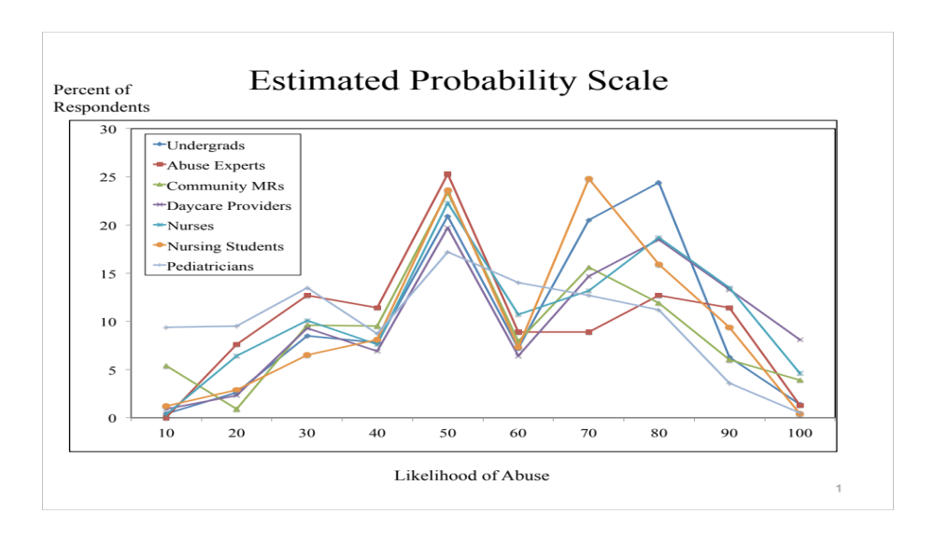
What counts as reasonable suspicion?

Slide 8
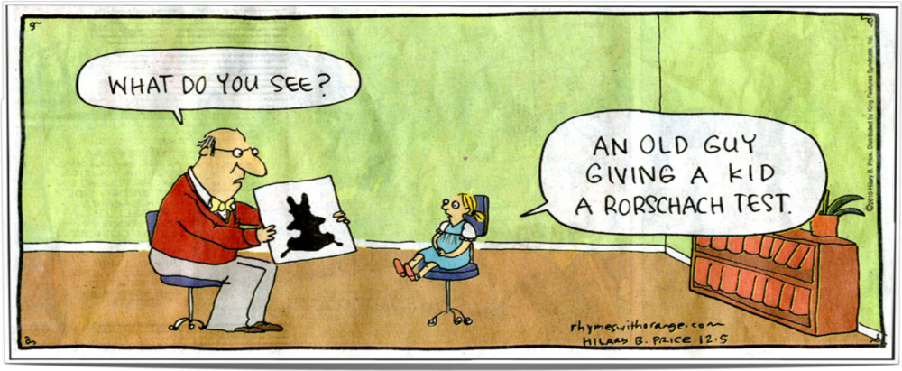

Interpreting “Reasonable Suspicion”
Notes:
OPTIONAL
spank.tiff: www.bygosh.com/huckfinn/ hf04.htm

Slide 9
Circuitous Path of Inquiry
Conceptual analysis
Empirical studies
Policy & program development

Slide 10
Policy & Programs
Ethics & Child Abuse –Bioethics for Clinicians, Cambridge University Press (2008)
Reasonable Suspicion: Finding A Common Language
What is Reasonable Suspicion of Child Abuse?
Look Out for Child Abuse website
Pennsylvania’s 1st online tool for reporting suspected abuse
J. Law, Medicine, & Ethics (2011)
J. Public Welfare (2012)

Slide 11

Circuitous Path of Inquiry
Conceptual analysis
Educational
Innovation
Empirical studies
Policy & program development

Slide 12

Who to Help First
Young children (0-5 years-old)
    Are more vulnerable
    Account for >75% of deaths
Cathleen Palm
Center for Children’s Justice
Childcare providers (CCPs)
    8-12 million children
    Unique position
    Mandated reporters
  …BUT
Make <0.5%
of all reports
– or just 2,500 of 680,000
Notes:
12
CCPs may be the only people outside of immediate family to have extended opportunities to observe children on a daily basis.

Slide 13






Supporters
Dr. Jane Keat
CAECTI
Mandy Mundy
Network of Victims Assistance
Dr. Susan McHale
Social Science Research Center
Dr. Karen Bierman
Early Childhood Research Center

Slide 14




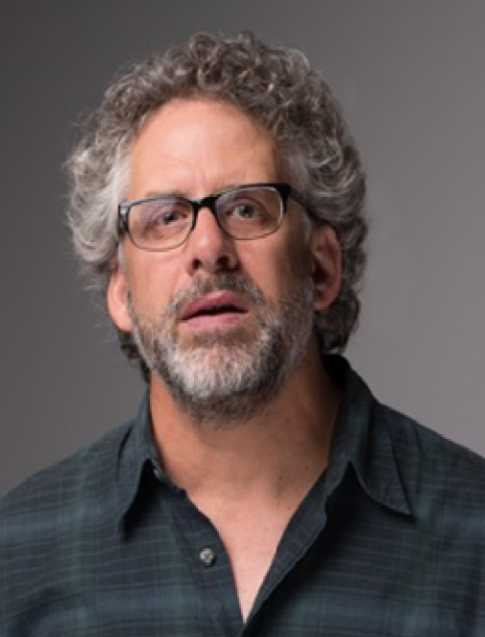










Educational Innovation
Nicole Verdiglione
Project Manager
Sara Dore
Site Director
Bre Grable
Research Specialist
Andy Belser
Creative Director
Cynthia White
Producer
Cody Goddard Filming / Editing
Rob Hamm
Decision Psychologist
Rick Fiene
Child Psychologist
Karl Kapp
Gamification
Claudia Mincemoyer
Better Kid Care
Carlo Panlilio
Educational Psychologist
Beth Myers
Game Animator
Chengwu Yang
Statistician
Erik Lehmann
Statistical Analyst

Slide 15
Challenges
Child abuse can be difficult to detect
CCPs receive little training re. abuse
Huge variability amongst CCPs
Need to avoid both under- & over- reporting
Parents are also “customers”
Notes:
15
Fear of reprisal
Obligation to children and to employer/client
14% substantiation vs. other

Slide 16
Challenges
Most training is linear, flat, …un-engaging
Principles of effective adult education
    Learners appreciate WHY it’s important
    Experiential learning process
    Learning as problem-solving
    Material has immediate value
    Considers learner’s prior knowledge
Notes:
We know that…

Slide 17
Initial Goal / Research Question
  Create
    An engaging, effective online learning program
Evaluate
    Effect on CCPs’ knowledge and attitudes regarding suspected child abuse and its reporting
    Eventually... changes in CCPs’ behavior

Slide 18
iLookOut for Child Abuse
The power of stories
Principles of “GAMIFICATION”
    Engage the learner
    Challenge w/ tasks that involve uncertainty, hidden information, & multiple goals
    Motivate learning through problem-solving
    Create safe environment to practice (and to fail)
Notes:
Gamification facilitates and motivates individuals by using game elements, game mechanics, and game-based thinking.

Slide 19
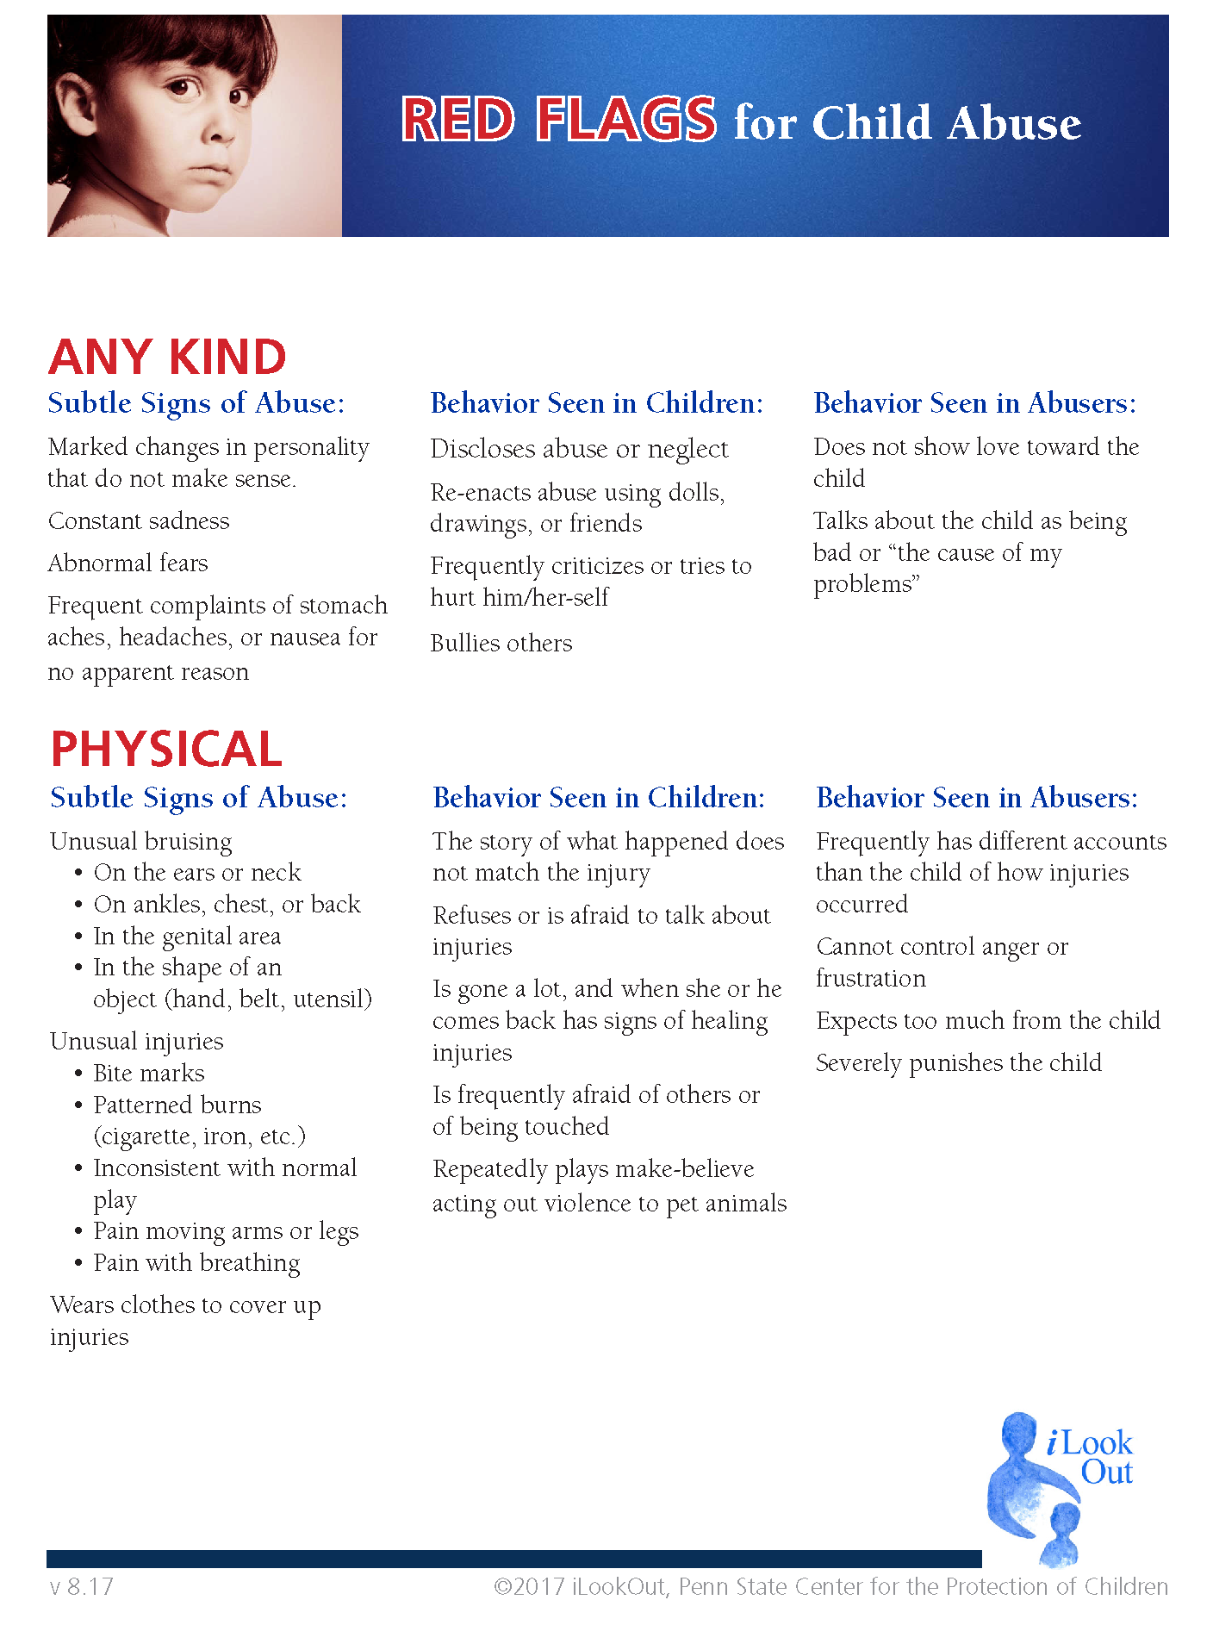
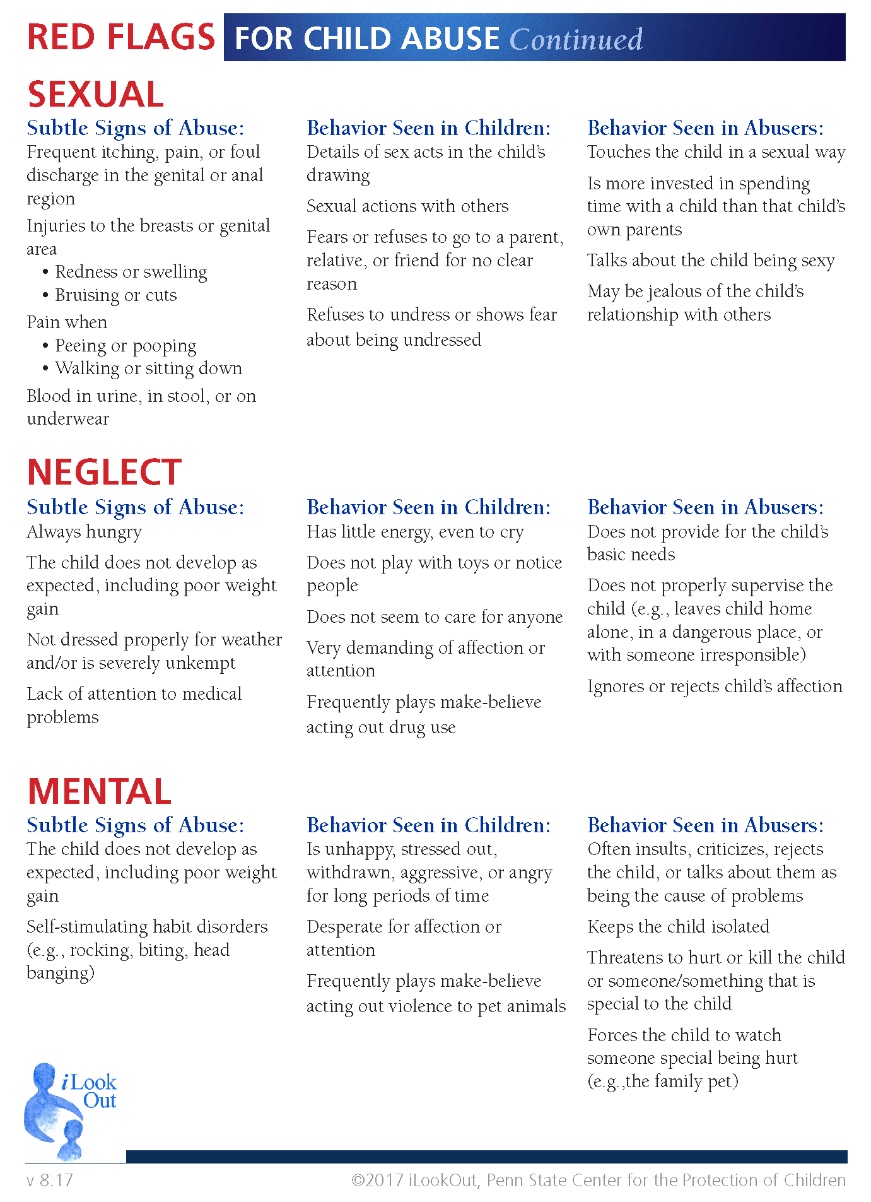

Notes:
Red Flags for Child Abuse Handout

Slide 20
Which of the following is NOT a possible sign of abuse?
A. Behavior problems
B. Unusually shy
C. Frequently tearful
D. Always hungry
E. Frequent injuries
A. Behavior problems → Actually, it can be.
As you know, there are many reasons why children “act out.” When the reason is that the child is being abused, it’s common to see increased anger, hostility, tantrums, and aggression. Abused children may have inappropriate emotional outbursts and argue excessively with adults and other children. Aggressive behavior is particularly seen among children who have been physically abused and/or witnessed domestic violence.
Notes:
[LM-7]: “POSSIBLE SIGNS OF ABUSE”

Slide 21
Which of the following should make you think carefully about possible abuse?
A. A significant change in a child’s behavior
B. Bruises on a child
C. Significant family stress
D. Frequent illnesses
E. Poor growth
B. Bruises on a child → This is an iffy one, and one that requires some extra thought. Bruises are a huge red flag in any child who isn’t yet walking or cruising, OR if they are located in places where it is not typical for children to fall or bump into things (e.g., chest, back, ears, neck, ankles, or private parts), OR if bruising is particularly frequent or extensive.
But because toddlers naturally explore their environment, it’s normal for toddlers to have bruising on their shins and forearms and foreheads —the places they land when they tumble. When you see bruises, ask yourself whether there’s a good explanation for why they’re there.

Slide 22
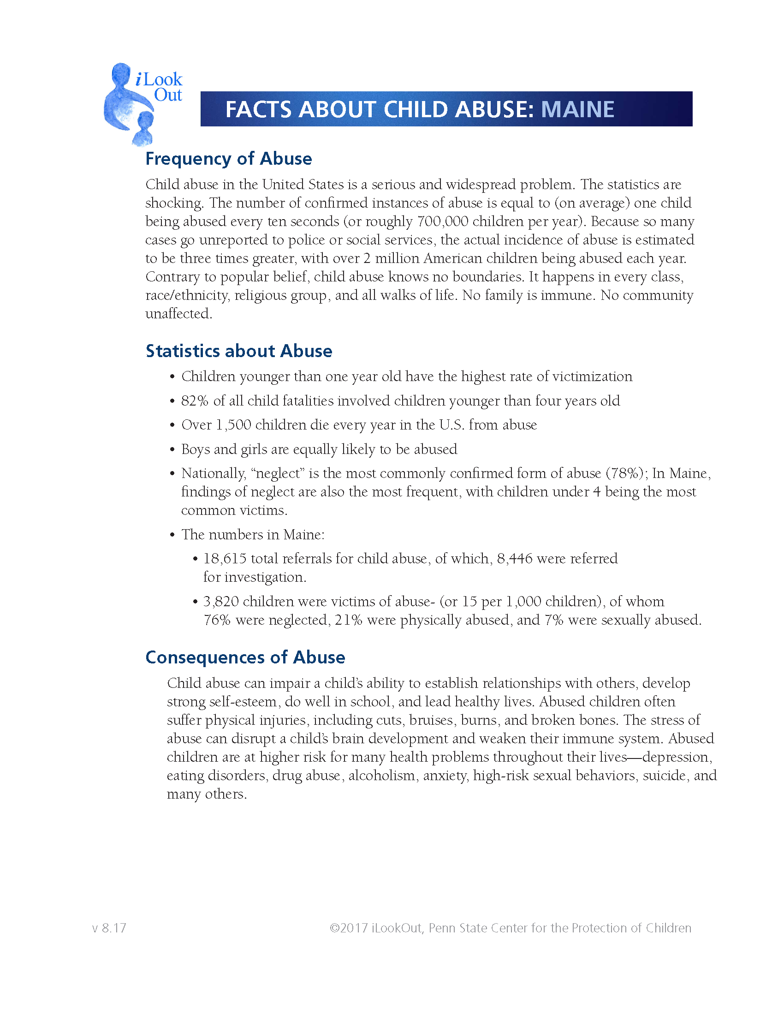
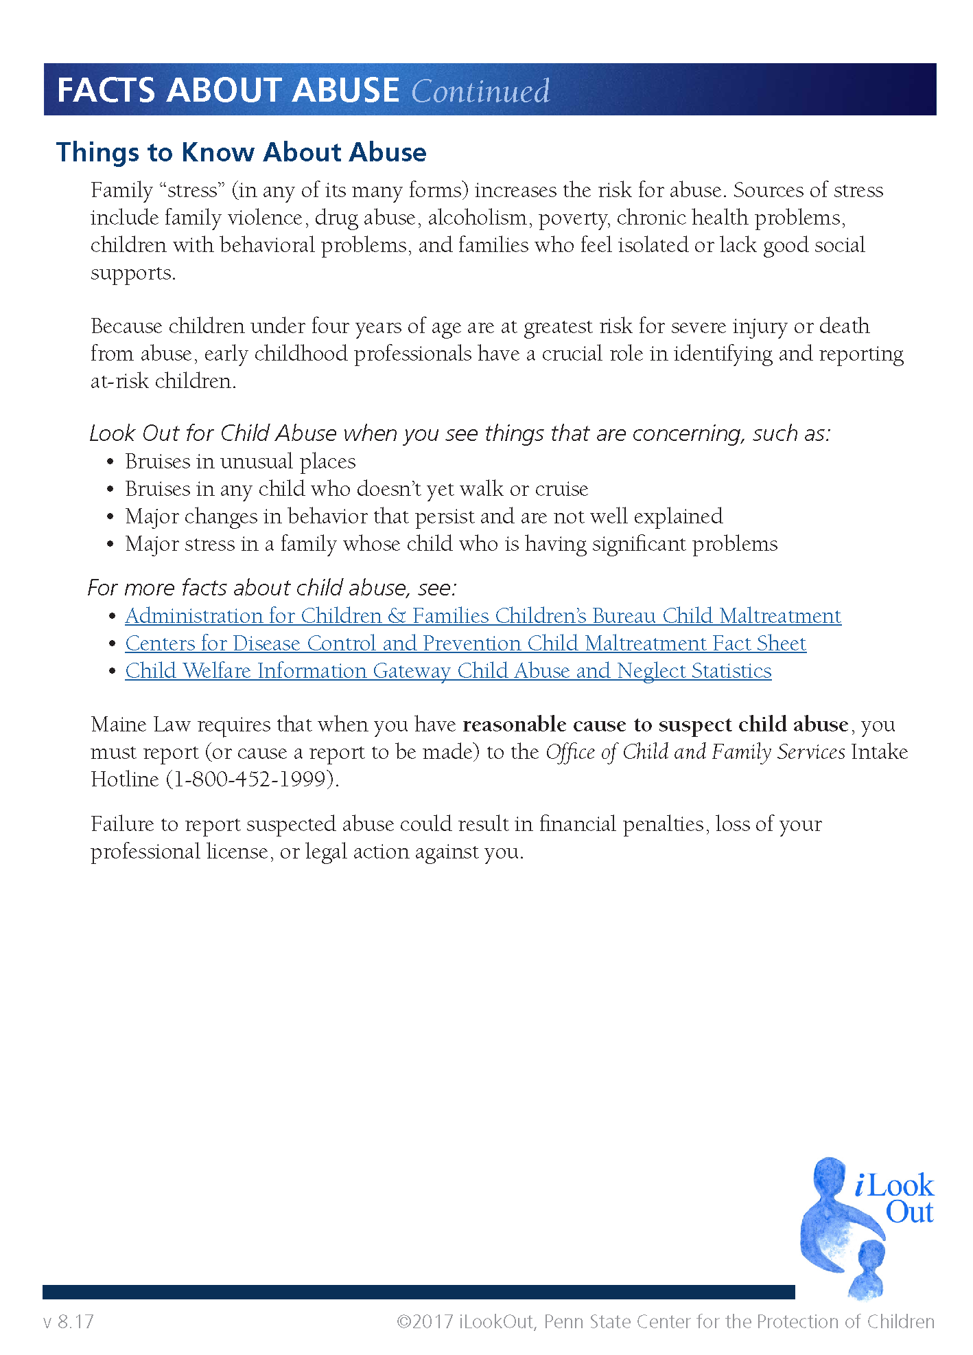

Slide 23
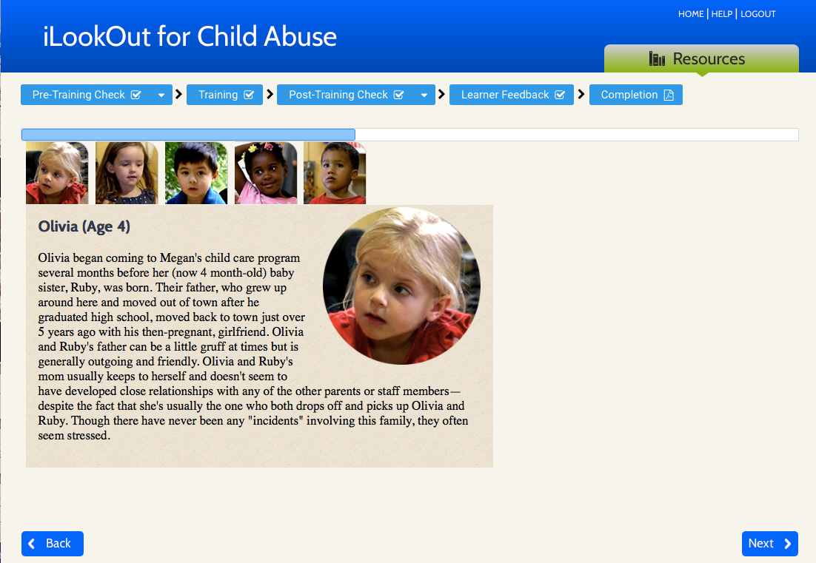
Notes:
We then provide the learner with the opportunity to learn more about each child, and remind them that the more one knows about a given situation, the better they’ll be able to figure out when to be concerned.

Slide 24
Reporting Suspected Abuse
You are required to report suspected child abuse if ________.
You have “Reasonable Cause to Suspect” that abuse has occurred
You have proof that a child has been abused

Slide 25
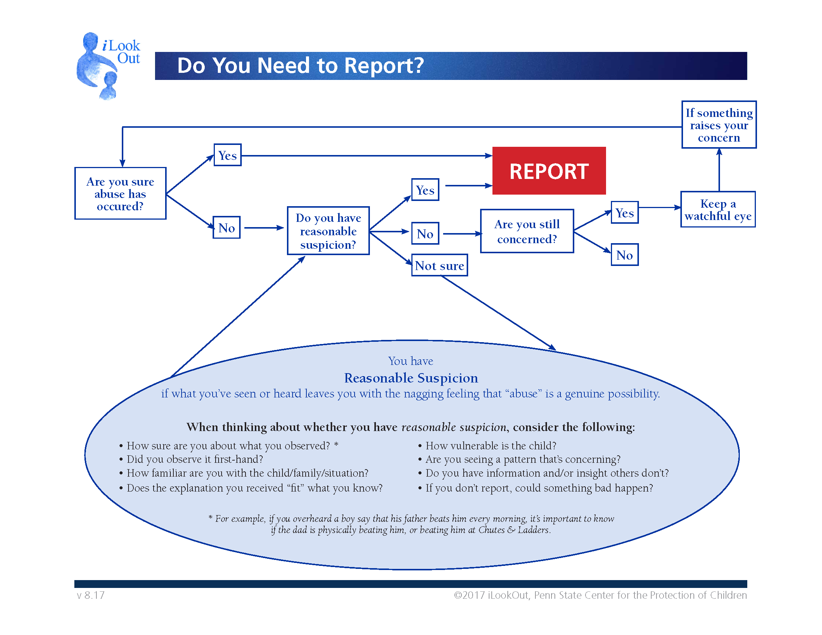

Slide 26
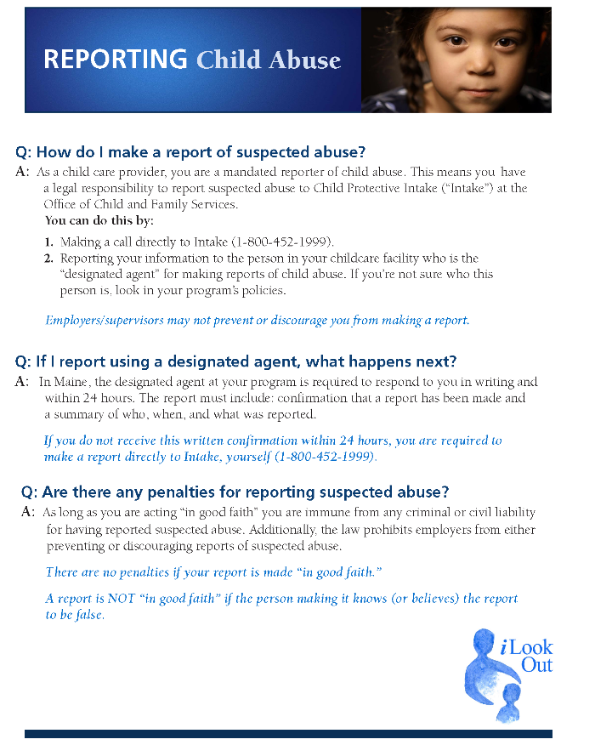
Notes:
LM-21

Slide 27

Notes:
We then walk learners through the

Slide 28
Notes:
LM-21

Slide 29


Slide 30
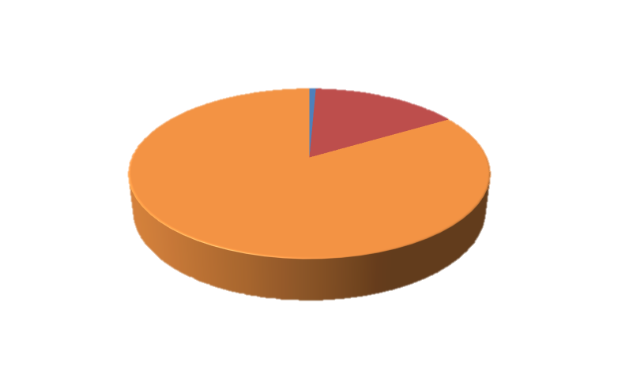
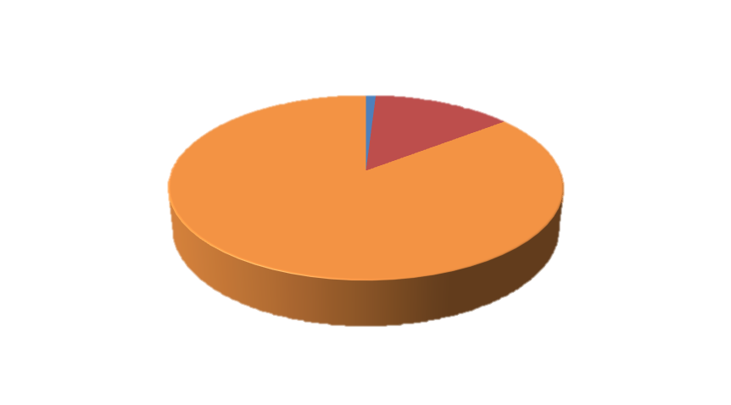
Is iLookOut effective?
The interactive storyline was a helpful way to learn about my responsibilities as a mandated reporter.
I would recommend this program to other childcare providers.
The interactive storyline was a helpful way to learn about my responsibilities as a mandated reporter.
I would recommend this program to other childcare providers.
Disagree Neutral Agree
Disagree Neutral Agree
Disagree Neutral Agree
Disagree Neutral Agree

Slide 31
Phase 1: Randomized Controlled Trial
  Single-blind
  Test / Re-test design (baseline vs. post-intervention)
  Attitudes (13-items, adapted from previously validated)
  Knowledge (21-items, validated by expert review)
  Recruitment (state-wide mailing to Directors)
  Randomization (of individual CCPs)
    Age, Parental status, Education, Years as CCP,
    Size of facility, Rurality
The interactive storyline was a helpful way to learn about my responsibilities as a mandated reporter.
I would recommend this program to other childcare providers.
The interactive storyline was a helpful way to learn about my responsibilities as a mandated reporter.
I would recommend this program to other childcare providers.
Disagree Neutral Agree
Disagree Neutral Agree
Disagree Neutral Agree
Disagree Neutral Agree
Notes:
baseline knowledge of the legal reporting duty and attitudes towards reporting
State-wide mailing lists: PACCA, Better Kid Care, OCDEL

Slide 32
Phase 1 Results
  762 CCPs enrolled –374 Control, 388 Intervention
  735 CCPs completed (96%)
  450 agreed to re-contact (61% RR)
  201 follow-up testing (44% RR)
The interactive storyline was a helpful way to learn about my responsibilities as a mandated reporter.
I would recommend this program to other childcare providers.
The interactive storyline was a helpful way to learn about my responsibilities as a mandated reporter.
I would recommend this program to other childcare providers.
Disagree Neutral Agree
Disagree Neutral Agree
Disagree Neutral Agree
Disagree Neutral Agree
Notes:
Those who agreed to be re-contacted were more likely to be >30 (66% v. 50%) and be parents (65% v 53%)

Slide 33
Knowledge (Scale = 0-21)
Knowledge | Pre | Post | Follow-up | Statistically significant
Control | 13.53 | 13.59 |  | NO (0.58)
Intervention | 13.54 | 16.19 |  | YES (<0.001)
15.16
Effect Size: 0.95 (p<0.0001)
4 Months: 0.75
The interactive storyline was a helpful way to learn about my responsibilities as a mandated reporter.
I would recommend this program to other childcare providers.
The interactive storyline was a helpful way to learn about my responsibilities as a mandated reporter.
I would recommend this program to other childcare providers.
Disagree Neutral Agree
Disagree Neutral Agree
Disagree Neutral Agree
Disagree Neutral Agree
Notes:
Knowledge: 64% correct ---> to 78% correct
In the intervention group, 1 knowledge item (3c) underwent highly marked change (large effect size 0.87, p < 0.001), 14 items
changed with medium effect sizes 0.22 to 0.77 (items 1d, 1e, 1f, 1g, 2a, 2b, 2c, 2e,3a, 3b, 5, 6, 7, 9; all p < 0.001), and 6 items changed with small effect sizes (items 1a, 1b, 1c,
2d, 4, 8; all p < 0.001).
Effect size: 0.2 = small, 0.5 = medium, 0.8 = large, for both Cohen’s d and Cohen’s h.

Slide 34
Attitudes (Scale = 1-7 Likert, 0.5 unit, p<.001)
  Greater confidence: Reporting → positive difference
  Less concern over legal liability for reporting
  Greater conviction that reporting suspected abuse:
    Improves a child’s safety
    Promotes a child’s long-term interests
    Results in helpful services
    Should occur even if supervisor disagrees
Notes:
All 13 Attitudinal items changed positively with medium effect sizes from 0.22 to 0.52 (all p < 0.001), with 3 items (h, i, k) changing with effect sizes exceeding 0.5.
Attitudinal average: Effect size = 0.98 (p<0.001), and at 4 months: 0.56

Slide 35
Preparedness (p<.001)
The interactive storyline was a helpful way to learn about my responsibilities as a mandated reporter.
I would recommend this program to other childcare providers.
The interactive storyline was a helpful way to learn about my responsibilities as a mandated reporter.
I would recommend this program to other childcare providers.
Disagree Neutral Agree
Disagree Neutral Agree
Disagree Neutral Agree
Disagree Neutral Agree

Slide 36
Satisfaction
  Overall satisfaction: 8.7 (1=low; 10=high)
  Kept their interest: 6.1 (7-point scale; 7=high)
  Provided useful information: 6.4 (7-point scale)
  Interactive storyline was effective: 6.4 (7-point scale)

Slide 37
Representative Comments
“As a child care provider this opened up my eyes a lot! This was an awesome child abuse training!”
“I found it extremely helpful to have the discussion and behind the scene evaluations –seeing the thought process unfolded.”
“I loved that it was interactive with videos.”
“I really liked having the resource library at your fingertips to refer to.”
The interactive storyline was a helpful way to learn about my responsibilities as a mandated reporter.
I would recommend this program to other childcare providers.
The interactive storyline was a helpful way to learn about my responsibilities as a mandated reporter.
I would recommend this program to other childcare providers.
Disagree Neutral Agree
Disagree Neutral Agree
Disagree Neutral Agree
Disagree Neutral Agree

Slide 38
Phase 2 Results
Open Enrollment Across PA (Jan. 2015 –)
  >11,000 child care providers ...and counting
  Demographics
  Pre-/Post- Knowledge & Attitudes
  Satisfaction
Results are almost identical to Phase 1 data
The interactive storyline was a helpful way to learn about my responsibilities as a mandated reporter.
I would recommend this program to other childcare providers.
The interactive storyline was a helpful way to learn about my responsibilities as a mandated reporter.
I would recommend this program to other childcare providers.
Disagree Neutral Agree
Disagree Neutral Agree
Disagree Neutral Agree
Disagree Neutral Agree

Slide 39

Phase 3: Implementation Phase
Now …Maine!
Evaluate Impact on :
  Reporting rates
  Substantiation rates
  Social services resulting from reports
The interactive storyline was a helpful way to learn about my responsibilities as a mandated reporter.
I would recommend this program to other childcare providers.
The interactive storyline was a helpful way to learn about my responsibilities as a mandated reporter.
I would recommend this program to other childcare providers.
Disagree Neutral Agree
Disagree Neutral Agree
Disagree Neutral Agree
Disagree Neutral Agree

Slide 40
Goals & Research Question
Evaluate
  Effect on CCPs’ actual reporting behaviors
  Impact on 1) quality of CCP reports, and 2) resource allocation
Explore the value of “Ping-ing”
  ...more on this later

Slide 41

“Quality” of Reports
(of suspected abuse)
Screened-Out Reports =
Low Yield
Depends on outcome of investigation
Screened-In Reports:

Slide 42
“Quality” of (investigated) Reports
Social Services Recommended
No
Yes
Low Yield
Medium Yield
No
Abuse
Confirmed
Medium Yield
High Yield
Yes

Slide 43
Study Design
  Randomized controlled trial
  3 Study Arms
  iLookOut
  Standard (Maine’s current online training)
  Control
  Will examine outcomes
  Reports by CCPs (de-identified)

Slide 44

Recruitment
Recruitment:
  All licensed childcare programs
    Home-based, Centers, Head Start, Preschool
  I-95 Corridor in Maine
  Randomized by “child care program”
    Based on program characteristics (size, type, rurality etc.)
Notes:
Type (Family, Head Start, Center, Nursery School, Preschool)
Rurality (distance from services) = RUCA
Rurality (US census)
Size (<10, 11-25, > 25)
QRIS rating

Slide 45
Role-Out
Yr 1
Yr 2
Yr 3
Yr 4
iLookOut
iLookOut
State-wide roll out
of
iLookOut
Standard
Standard
iLookOut
Control
iLookOut

Slide 46
And yet...
We know that
knowledge
Notes:
So that’s the 3-hour iLookOut learning program.

Slide 47
App

Slide 48
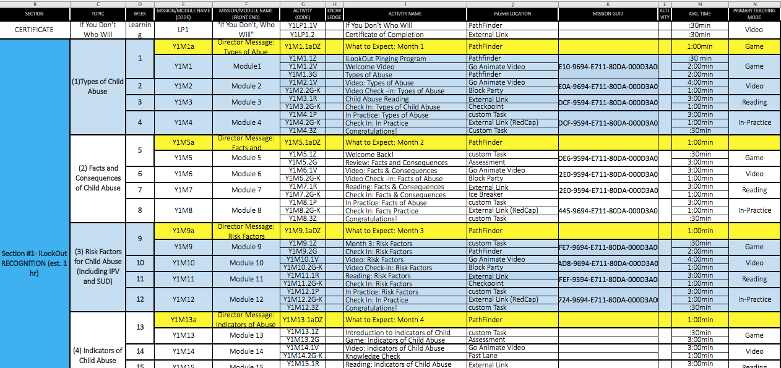
Pinging Game Plan

Slide 49
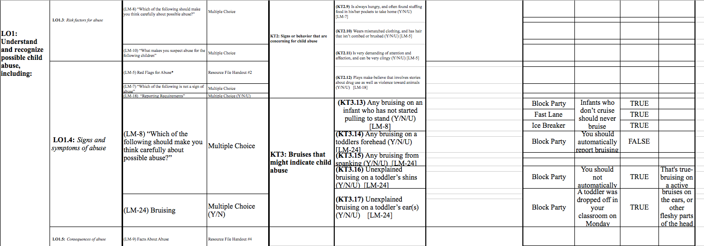
Cognitive Sequencing Map

