Slide 1
Regulatory Theory & Global Implications
Dr. Sonya Stevens
NARA

Slide 2
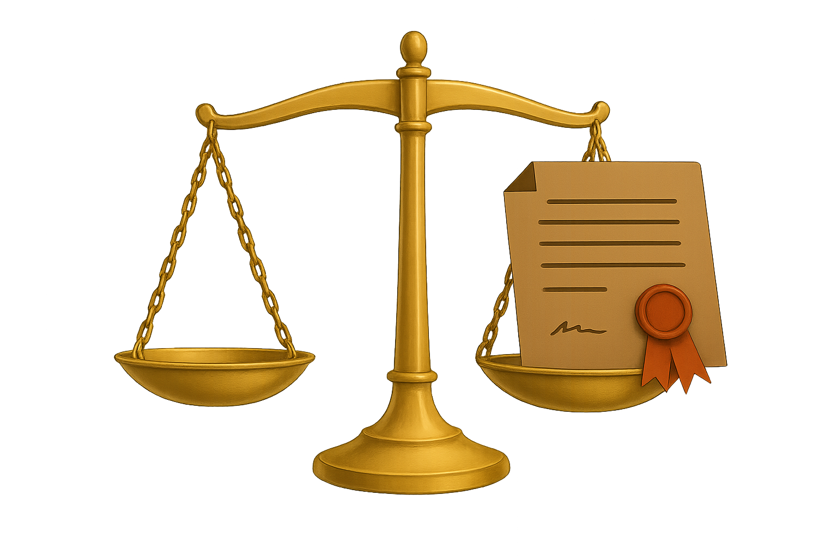
Regulatory Theory and Licensing
Objectives
Introduce the theories driving licensing policies across the globe
Learn how rules shape our economic behavior
Discuss current trends and driving forces within the shifting landscape
Notes:
“Before we get into global examples, I want to briefly ground us in the big picture—what regulatory theory is, and why licensing sits at the center of it.”
Regulatory theory helps us understand why governments regulate, how systems are designed, and what they’re actually trying to accomplish. At its core, it asks a few practical questions:
What risks are we managing?
Who are we protecting?
And how much oversight is enough to prevent harm without creating new problems?
Licensing is one of the most powerful tools we use to answer those questions. It acts as a gatekeeping mechanism—allowing people or organizations to operate only if they meet defined standards. In human services, those decisions directly affect children, families, and vulnerable populations, which makes licensing both a safety tool and a statement of public values.
What’s important to remember is that regulatory theory isn’t abstract. It shapes how inspections are carried out, how discretion is used, how providers experience oversight, and ultimately how effective licensing is at preventing harm.
“So as we move forward, I invite you to think like system designers—considering not just what the rules say, but how they actually function in practice.”

Slide 3
Theoretical Background
Notes:
Transition Slide

Slide 4
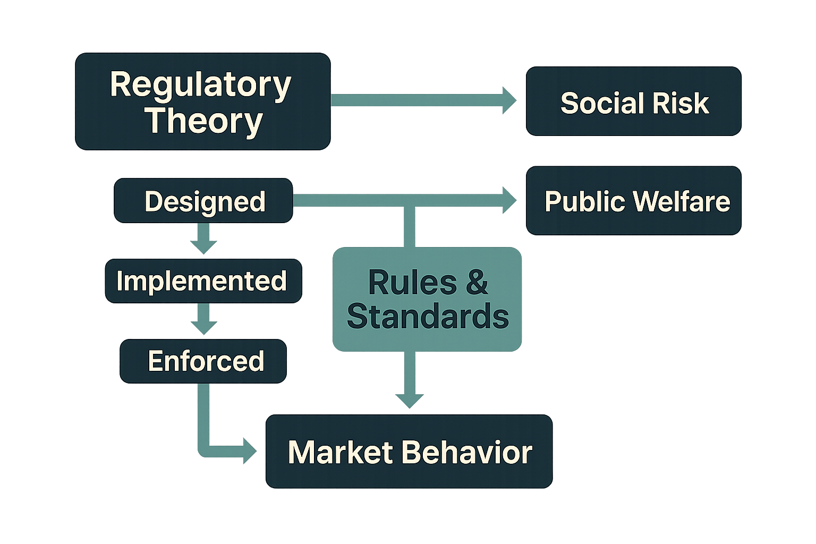
What is Regulatory Theory
Examines how rules and standards are:
  Designed
  Implemented
  Enforced
Aims to manage:
  Market behavior
  Social risk
  Public welfare
Notes:
At its most basic level, regulatory theory looks at how rules actually shape behavior.” It examines three core things: How rules are designed, How they are implemented, And how they are enforced.
The goal of regulation isn’t control for its own sake. It’s about managing risk, influencing market and organizational behavior, and protecting public welfare—especially where harm is hard for consumers to see or measure on their own.
Regulatory theory helps explain why regulators intervene in certain spaces and how they decide what level of oversight is appropriate. It also helps us understand why the same rule can work well in one context and fail in another. “So regulatory theory gives us a lens—not just for what the rules say, but for how regulatory systems actually function in practice.”
This sets up why licensing, in particular, plays such a central role.

Slide 5
Licensing as a Regulatory Tool
Quality
Access
Risk
Grants permission to operate
Requires meeting defined standards
Functions as a:
  Quality assurance mechanism
  Risk control tool
  Barrier or filter for market entry
Notes:
“Licensing is one of the most direct tools regulators use to shape behavior.” At its most basic level, licensing grants permission to operate, but only after defined standards are met. That allows governments to set minimum expectations around safety, competence, and quality before harm occurs. Functionally, licensing does three things at once.
It serves as a quality assurance mechanism, signaling to the public that minimum standards are in place.
It operates as a risk control tool, limiting who can provide services where harm would be difficult for consumers to detect on their own.
And it acts as a filter or barrier to market entry, shaping who is allowed to participate in a field.
That last point matters. Licensing doesn’t just protect—it also structures markets and systems. The way standards are written and enforced influences access, workforce supply, innovation, and equity. “So licensing is never neutral.” It reflects judgments about acceptable risk, public protection, and how much oversight is appropriate. Understanding licensing as a regulatory tool—rather than just a checklist—is key to understanding why different systems succeed or struggle.

Slide 6

Public Interest Theory
The Public Interest Theory emphasizes licensing for quality control, preventing negligence, and guaranteeing competent care in sensitive areas like elder care, mental health, and child care.
Purpose of Licensing
  Protect consumers
  Ensure safety and quality
Common Risks
May oversimplify political and social complexity
Can overlook diversity and individual needs
Underlying Assumption
  Consumers lack the information to assess quality
  Regulators act as neutral guardians of the public good
Notes:
“Historically, much of licensing in human services has been grounded in what’s called Public Interest Theory.” Public Interest Theory views licensing primarily as a protective measure. The core idea is that markets alone can’t always ensure safety or quality—especially in settings where consumers lack the information or expertise to evaluate risk on their own. Under this theory, licensing is used to:
Protect consumers
Ensure baseline safety and quality
Prevent harm in high‑stakes environments like child care, healthcare, and social services
The underlying assumption is that consumers can’t easily assess quality, so regulators step in as neutral guardians of the public good. Licensing helps reduce information asymmetry by assuring the public that minimum standards are met before services are delivered. This framework has been especially influential in human services, where the people affected—children, older adults, individuals with disabilities—often can’t advocate for themselves.
However, Public Interest Theory also has limitations. It can oversimplify how rules are made and enforced, overlook political and organizational incentives, and assume that one set of standards works equally well for all communities and providers. “That doesn’t make the theory wrong—but it does make it incomplete.” Over time, scholars and policymakers began asking a different question:
What happens when regulatory systems are shaped not just by public need, but by incentives, politics, and professional self‑interest? That question leads us directly into Public Choice Theory, which offers a more critical lens on how licensing systems actually evolve—and who they may end up serving. “So next, we’ll look at what Public Choice Theory adds to this conversation, and why it has become increasingly influential in modern licensing debates.”

Slide 7

Public Choice Theory
The Public Choice Theory focuses on the "rent-seeking" behavior, arguing that rigorous licensing acts primarily as a barrier to competition rather than a safeguard for the public.
Purpose of Licensing
Rules may prioritize Licensees over consumers
Regulation can become a tool for economic protectionism
Common Risks
Influenced by incumbent professionals
Reduced competition and innovation
Underlying Assumption
Regulators and professionals respond to incentives, just like market actors
Notes:
The 2020s have seen a significant rise in Public Choice perspectives, leading to the following global trends: “Public Choice Theory offers a more critical way of looking at licensing systems.”
Where Public Interest Theory focuses on protection, Public Choice Theory asks us to look closely at incentives. It starts from a simple assumption: regulators, professionals, and policymakers respond to incentives—just like everyone else. From this perspective, licensing doesn’t always serve consumers first. Instead, rules can be shaped by incumbent professionals who benefit from limiting competition. Higher standards may raise quality in some cases—but they can also function as barriers to entry, reducing access, innovation, and workforce supply. Public Choice theory highlights several common risks:
Regulation influenced by existing providers
Reduced competition and innovation
Higher costs or wages without clear quality gains
In this view, licensing can become a form of economic protectionism, where rules protect providers more than the public. That critique has become increasingly influential—especially in lower‑risk service sectors and in recent debates about occupational licensing, child care access, and workforce shortages in the U.S.
“Public Choice Theory doesn’t argue that regulation is unnecessary—but it asks us to be honest about who benefits from the rules we maintain.” This lens helps explain why we’ve seen growing pressure to reform, streamline, or replace some licensing systems—and it sets up the central question we’ll explore next: If both protection and incentives matter, how should licensing systems actually be designed and administered in practice?

Slide 8
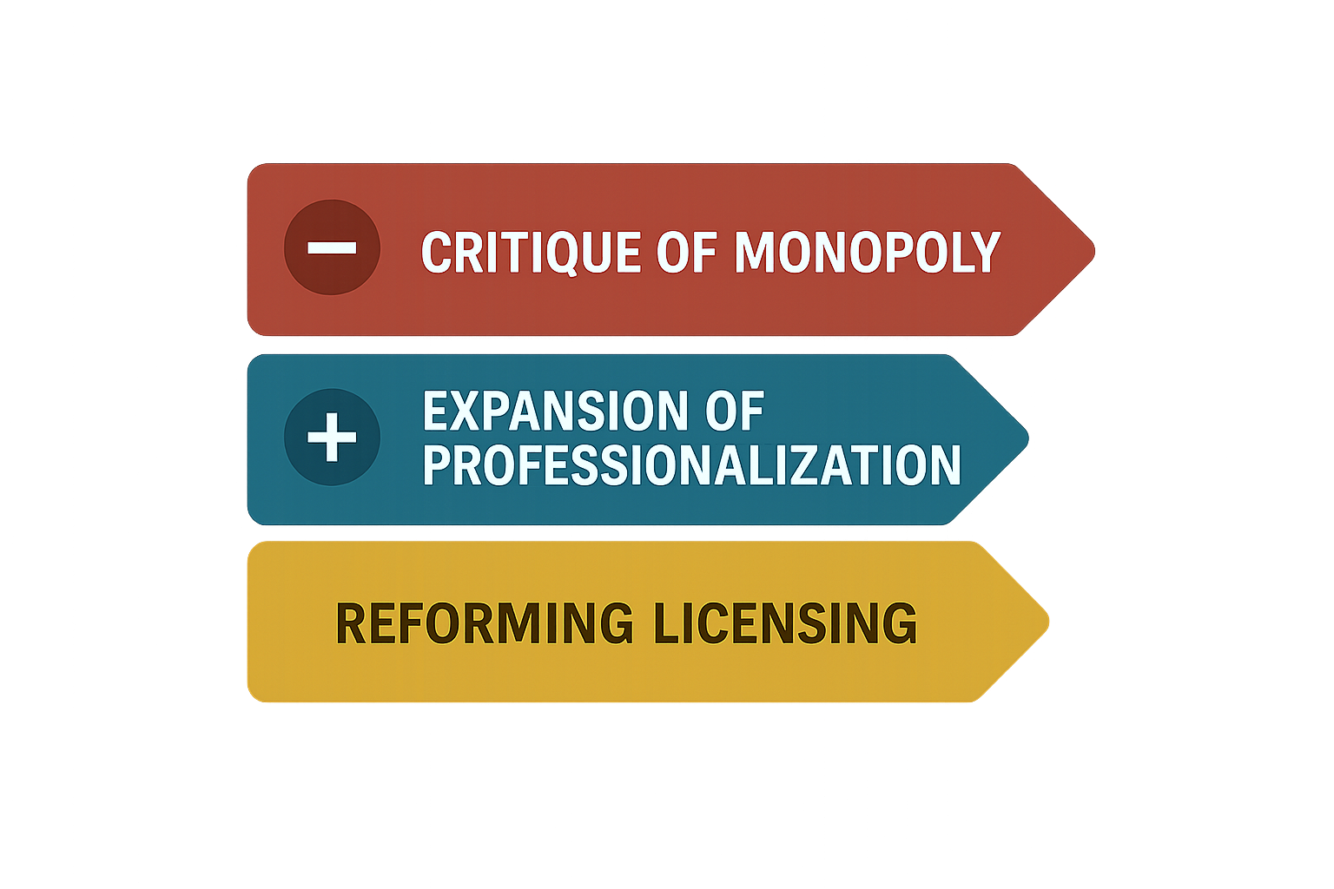
Current Trends (2024-2026)
A push to reduce regulations and/or favor certification over licensing to lower barriers to entry.
A trend toward increased licensing in fields such as social work to ensure safety and equity.
Global momentum toward reforming licensing to remove unnecessary hurdles that limit access.
Notes:
“So when we look at current licensing trends—both in the U.S. and globally—we see these theories playing out very clearly in practice.” Across jurisdictions, there is growing momentum toward reforming licensing systems to remove unnecessary hurdles that limit access—especially in lower‑risk service areas. In many cases, this has meant reducing regulation or shifting from mandatory licensing to certification, with the goal of lowering barriers to entry and addressing workforce shortages. This trend reflects strong Public Choice influence. Critics argue that some licensing requirements are driven more by incumbent professionals than by demonstrable risk, and that overly rigid systems can reduce competition and access without clear gains in quality.
At the same time, there is a counter‑trend that’s just as important. In higher‑risk or rapidly evolving fields—such as social work and other human services—we’re actually seeing expanded licensing and professionalization. Here, the emphasis is on ensuring safety, equity, and accountability in complex environments. So the overall direction isn’t simply deregulation. It’s recalibration.
“Globally, licensing systems are being redesigned—not to do less, but to do better.” The focus is shifting toward more flexible, risk‑based frameworks, greater attention to access and workforce supply and, ongoing attempts to balance public protection with efficiency and innovation. This tension—between reducing unnecessary burden and strengthening protections where risk is real—sets the stage for the next question we’ll explore:
If both critiques and protections are valid, how should licensing systems actually be designed and administered in practice

Slide 9
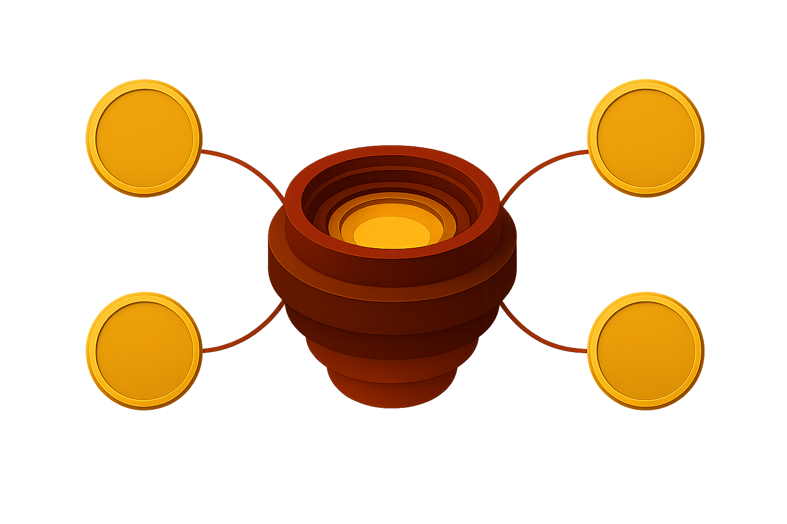
The “Third Lens”
Public Interest and Public Choice theories each explain part of licensing
Administrative Reality
Shift the Central Question
Emphasize Regulatory Craft
Link to Behavioral & Decision Sciences
Employ Practical Reform
Real‑world licensing systems operate under political constraints, limited resources, and human behavior
Notes:
Modern regulatory scholars argue that Public Interest and Public Choice theories each explain part of licensing—but neither fully captures how regulation actually works in practice. Real‑world licensing systems operate under political constraints, limited resources, and human behavior, requiring pragmatic compromise rather.
Let’s explore the administrative reality:
First, we have seen a significant shift in the Central Question. The policy debate has shifted from: “Should licensing exist?” to “How should licensing be designed and administered?”
Focus is placed on implementation quality, not merely regulatory intent.
Next, there has been an increased Emphasis on Regulatory Craft. This means attention has moved to rule clarity and usability, Proportional enforcement, Administrative discretion and Consistency and fairness in inspections. Each of these Recognizes that poorly administered rules can undermine even well‑intentioned policy goals.
Practical Reform Encourages a move to systems with risk‑based oversight, targeted enforcement, outcome‑focused standards and continuous regulatory learning and adjustment. It also supports incremental reform rather than large scale deregulation or expansion. We will talk more in-depth on this a bit later in the presentation.
Finally, we are seeing an increased link to behavioral & decision sciences. This aligns with behavioral compliance models and prospect theory that acknowledges that provider behavior is shaped by Perceptions of legitimacy, Clarity of expectations and Fear of loss vs. motivation to improve. If you are interested in this aspect, I will be doing another session specifically on this [fill in when] so we won’t spend time here going over it.
Bottom Line
Administrative Reality reframes licensing as a living system, not a static rulebook, finite statistical findings or software systems: Ultimately, effectiveness depends on how rules are applied. Smart regulation balances safety, feasibility, and trust while the regulator’s role shifts from enforcer to risk manager and system steward.

Slide 10
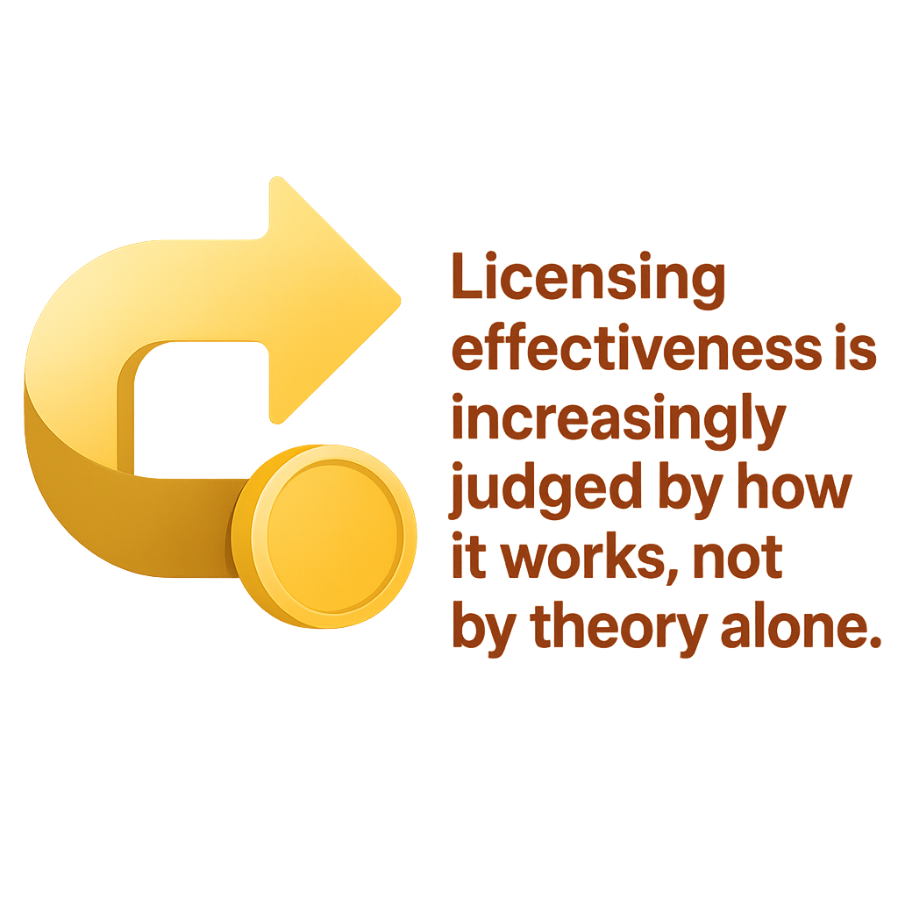
Shifting the Central Question
From “Should?” → to “How?”
Licensing is no longer debated primarily as an idea
The focus is now on design, implementation, and administration
Implementation Quality Matters
Clarity
Consistency
Proportionality
Administrative capacity
Design Questions Now Dominate
What level of risk warrants regulation?
Which rules predict safety and quality?
How should oversight differ by provider performance?
Notes:
For much of the 20th century, licensing debates centered on a binary question: Should licensing exist at all? Public Interest Theory answered “yes” to protect consumers. Public Choice Theory pushed back, highlighting barriers to entry and rent-seeking.
What has changed over the past two decades is that this debate is largely settled in most human services contexts. Licensing does exist, and the more pressing question has become:
How should licensing actually function in the real world? This represents a fundamental shift:
From policy justification → to policy execution
From ideology → to operations
From rule creation → to rule administration
The focus is now on implementation quality: Poorly designed or inconsistently enforced rules can cause harm—even if the intent is sound. Well-designed systems can achieve safety with fewer rules if those rules are targeted and meaningful.
Regulators increasingly ask practical design questions:
Are we regulating risk or formality?
Do all providers need the same level of scrutiny?
Which rules meaningfully predict harm or safety?
Once the central question becomes “how,” attention naturally turns to how regulation is actually practiced.

Slide 11


Fiene’s Theory of Regulatory Compliance
Substantial Compliance
Key Indicator System
Focuses on meaningful compliance; the level at which risk is effectively controlled
Allows regulators to focus inspection and monitoring efforts where they matter most.
Differential Monitoring
97–99% compliance
10–20% of regulatory rules
Data and Research
Driven by actual risk
Evidence Based Oversight
Risk Assessment
Shifts from equal enforcement of all rules to strategic prioritization
Decisions are based likelihood of harm & severity of harm
Notes:
“This slide introduces Fiene’s Theory of Regulatory Compliance, which represents a major shift in how we think about effective regulation.”
Let me start with the core idea: Fiene’s work challenges the traditional assumption that 100% compliance is always the goal. Instead, the theory asks a more practical question:
How do we maximize safety with the resources we actually have?
Substantial Compliance
(gesture to first node)
The model begins with Substantial Compliance.
Research shows that reaching about 97–99% compliance captures nearly all meaningful safety gains. Beyond that, additional enforcement produces diminishing returns while consuming disproportionate regulatory effort. This means there is no gain to health or safety with additional findings.
So rather than chasing perfection, this approach focuses on meaningful compliance—the level at which risk is effectively controlled.
Evidence‑Based Oversight
(move to center node)
From there, the model emphasizes Evidence‑Based Oversight.
This means regulatory decisions are guided by data and research, not intuition or tradition.
Oversight becomes smarter by asking: Which rules actually predict harm? Which compliance failures matter most?
This is a shift from equal enforcement of all rules to strategic prioritization.
Key Indicator Systems
(gesture to Key Indicator node)
That leads directly to Key Indicator Systems, one of the most important aspects of Fiene’s theory. A core feature of Fiene’s theory is the use of Key Indicator Systems—a small subset of rules that statistically predict overall compliance. Research suggests that reaching 97 to 99 percent compliance maximizes safety. Beyond this point, additional enforcement yields minimal benefit while consuming significant resources. Differential monitoring allows regulators to reward high performers with lighter oversight while targeting poor performers more intensively. What this does is focus on the oversight where risk is highest. It responds to the pacing problem when social change outpaces the process of lawmaking and uses common tools often found in risk stratification through data driven inspections.
Research consistently shows that 10–20% of regulatory rules predict overall compliance.
These key indicators act as early warning signals—if a provider is compliant in these areas, they are statistically likely to be compliant overall.
This allows regulators to focus inspection and monitoring efforts where they matter most.
Risk Assessment
(move upward to Risk Assessment node)
Once key indicators are identified, regulators apply Risk Assessment.
Here, decisions are based on:
Likelihood of harm
Severity of harm
This ensures oversight intensity is driven by actual risk, not uniformly applied standards or administrative convenience.
Differential Monitoring
(end at arrow node)
Finally, the model results in Differential Monitoring—the operational payoff of the entire system.
High‑performing providers receive lighter, abbreviated oversight
Lower‑performing or higher‑risk providers receive more intensive monitoring
This creates a system that is:
Fairer
More efficient
More effective at preventing harm
Closing Line / Transition
“In short, Fiene’s theory reframes regulation as a targeted, evidence‑driven system—one that allocates attention where risk is greatest, rather than enforcing uniform compliance for its own sake.”
This sets the foundation for understanding risk‑based regulation and regulatory craft, which we’ll explore next.

Slide 12

Emphasis on Regulatory Craft
Rule Clarity and Usability
Clear, understandable rules improve compliance
Reduces unintentional violations and confusion
Proportional Enforcement
Regulatory responses align with severity of risk
Distinguishes technical errors from meaningful harm
Administrative Discretion
Judgment is guided within structured boundaries
Balances flexibility with accountability
Consistency and Fairness in Inspections
Shared standards and calibrated inspectors
Builds legitimacy and trust in the system
Well‑designed policies succeed or fail based on how they are administered.
Notes:
“Once we understand that regulation is about how systems work in practice, attention naturally shifts to something called regulatory craft.”
Regulatory craft refers to how rules are written, applied, interpreted, and enforced on the ground. It recognizes that even well‑designed policies can fail if they are implemented poorly.
This is where regulation moves from theory into administrative reality.
Rule Clarity and Usability
The first element of regulatory craft is clarity. Rules must be understandable not just to lawyers or regulators, but to the providers expected to comply with them.
Ambiguous or overly complex rules increase:
Unintentional non‑compliance
Inconsistent enforcement
Perceptions of unfairness
Clear, usable rules improve compliance without increasing enforcement pressure.
Proportional Enforcement
Next is proportional enforcement. Not all violations pose the same level of risk, and regulatory responses should reflect that. Regulatory craft asks:
Is the response aligned with the severity of harm?
Does enforcement distinguish between technical errors and meaningful risk?
This aligns closely with risk‑based regulation and avoids “checklist enforcement” that focuses on form rather than safety.
Administrative Discretion
Another critical component is administrative discretion. Front‑line inspectors and regulators inevitably exercise judgment. Regulatory craft does not eliminate discretion—it guides and structures it. Well‑designed systems:
Set clear boundaries for discretion
Support decision‑making with data and guidance
Reduce variability while allowing flexibility in complex cases
Poorly designed systems either over‑constrain staff or leave too much interpretation, leading to inconsistency.
Consistency and Fairness in Inspections
Consistency is central to legitimacy. When similar providers receive very different outcomes for similar conditions, trust erodes—both among providers and the public. Regulatory craft emphasizes:
Shared standards
Training and calibration of inspectors
Documentation of decision logic
This does not mean identical outcomes, but defensible, explainable decisions.
Why Regulatory Craft Matters
This slide underscores a key insight: Poorly administered rules can undermine even well‑intentioned policy goals. You can have:
Strong public interest objectives
Evidence‑based standards
Sophisticated risk models
But if the regulatory system lacks craft—clarity, proportionality, fairness—it will fail to achieve its purpose.
Transition to the Next Section
“Regulatory craft is where policy effectiveness is either realized or lost.”
This emphasis on craft sets up the next discussion on risk‑based regulation in practice, where we see how these principles are operationalized in real systems.
Rule Clarity and Usability
Clear, understandable rules improve compliance
Reduces unintentional violations and confusion
Proportional Enforcement
Regulatory responses align with severity of risk
Distinguishes technical errors from meaningful harm
Administrative Discretion
Judgment is guided within structured boundaries
Balances flexibility with accountability
Consistency and Fairness in Inspections
Shared standards and calibrated inspectors
Builds legitimacy and trust in the system
Well‑designed policies succeed or fail based on how they are administered.
Closing Line / Transition
“In short, Fiene’s theory reframes regulation as a targeted, evidence‑driven system—one that allocates attention where risk is greatest, rather than enforcing uniform compliance for its own sake.”
This sets the foundation for understanding risk‑based regulation and regulatory craft, which we’ll explore next.

Slide 13
Risk-Based Regulation
Focused Oversight
Common Tools
Socially Responsive
Focuses oversight where risk is highest
Responds when social change outpaces lawmaking
Common tools:
  Risk stratification
  Data-driven inspections
Notes:
“Now that we’ve talked about regulatory craft—how rules are designed and applied—we can see how those principles come together in something called risk‑based regulation.”
Risk‑based regulation shifts oversight away from treating all providers the same and instead focuses attention where harm is most likely and most severe.
The central idea is simple:
Regulatory resources are limited, so they should be used where they make the greatest difference.
Focuses Oversight Where Risk Is Highest
In traditional regulatory systems, enforcement often aims for uniform coverage—everyone receives the same inspection intensity, the same timelines, and the same scrutiny.
Risk‑based regulation challenges that approach.
Instead of asking, “Are we enforcing every rule equally?”, it asks:
“Where is the real risk?”
This allows regulators to:
Spend more time on high‑risk providers
Reduce unnecessary oversight for consistently strong performers
Allocate limited staff and funding more strategically
The goal is harm prevention, not rule accumulation.
Responds to the Pacing Problem
Risk‑based regulation also responds to what scholars call the pacing problem—the reality that social, technological, and service delivery changes often happen faster than laws can be updated.
Licensing rules are often static, but:
Service models evolve
Risks shift
New forms of harm emerge
Risk‑based systems allow regulators to adapt without rewriting the entire rulebook by adjusting oversight intensity based on emerging risk signals.
Common Tools Used in Risk‑Based Regulation
In practice, risk‑based regulation relies on several operational tools:
First, risk stratification.
Providers are grouped by risk level based on factors such as compliance history, complaints, incidents, or key indicator performance.
Second, data‑driven inspections.
Inspection timing, scope, and depth are informed by evidence—rather than fixed schedules alone.
This creates a feedback loop where:
Data informs oversight
Oversight generates better data
Regulation becomes progressively smarter over time
Why This Matters
Risk‑based regulation represents a major cultural shift for regulators.
It moves the system:
From equal treatment → to equitable attention
From checklist enforcement → to risk relevance
From inspection as punishment → to inspection as prevention
Importantly, it does not mean deregulation.
It means intelligent regulation—maintaining safety while reducing unnecessary burden.

Slide 14

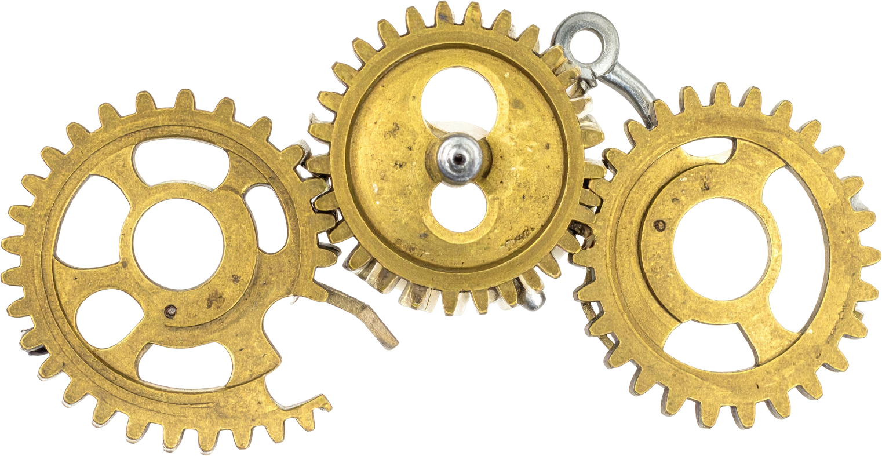


Employing Practical Reform
Risk‑Based Oversight
Targeted Enforcement
Oversight intensity is aligned with the level of harm, not applied uniformly for its own sake.
Rather than enforcing every rule evenly,
regulators focus attention on the areas that matter for safety and outcomes.
Outcome‑Focused Standards
Continuous Regulatory Learning
The emphasis shifts away from whether a box was checked and toward regulated outcomes.
Regulatory systems are treated as adaptive.
Notes:
At this point, we move from theory and design into action—how regulatory systems actually evolve in the real world.”
This slide is about practical reform. Not sweeping deregulation, and not rigid expansion—but deliberate, evidence‑guided adjustment over time.
Practical reform starts with an important recognition:
Most regulatory systems already exist. The real question is not whether to regulate, but how to improve what’s already in place. Instead of large‑scale overhauls, practical reform emphasizes:
Testing
Learning
Adjusting
Refining
This mirrors how complex systems actually change.
Practical reform encourages a move toward systems that emphasize four key features.
First, risk‑based oversight. Oversight intensity is aligned with the level of harm—not applied uniformly for its own sake. This builds directly on Fiene’s work and risk‑based regulation.
Second, targeted enforcement. Rather than enforcing every rule evenly, regulators focus attention on the areas that actually matter for safety and outcomes.
Third, outcome‑focused standards. The emphasis shifts away from whether a box was checked and toward whether the regulated outcome—such as safety, quality, or equity—was achieved.
Fourth, continuous regulatory learning. Regulatory systems are treated as adaptive:
Data informs oversight - Oversight generates feedback n- Rules and practices are adjusted over time
Why Incremental Reform Matters
A defining feature of practical reform is that it favors incremental change, not dramatic swings. Large‑scale deregulation or expansion often:
Triggers resistance
Creates implementation gaps
Undermines legitimacy
Incremental reform, by contrast:
Preserves institutional knowledge
Allows for course correction
Builds trust among providers and the public
This approach accepts that regulation operates under political, administrative, and human constraints.
Key Takeaway for the Audience
“Practical reform treats regulation as a living system—one that must be continuously calibrated rather than periodically dismantled or rebuilt.” In other words, the goal is not perfect regulation, but better regulation over time.
Facilitation Cue (Optional Pause)
At this point, you may want to pause briefly and ask:
Where have you seen incremental changes succeed more than large reforms?
What makes regulatory learning possible—or difficult—in your context?
Transition to the Next Section
“Once we understand how practical reform works, we can see its impact globally—across countries, sectors, and regulatory systems.”

Slide 15
Global Trends

Slide 16


Golbal Practices
This approach is not theoretical; it’s being actively applied across the globe!
Notes:
“So far, we’ve talked about risk‑based regulation as a concept. What’s important to understand is that this approach is not theoretical—it’s being actively applied across different regulatory systems around the world.”

Slide 17

United Kingdom
The UK uses a risk‑responsive inspection model
Notes:
Let’s start with the United Kingdom, through the work of the Care Quality Commission, or CQC. The UK uses a risk‑responsive inspection model.
Rather than inspecting all providers with the same intensity, the CQC targets oversight where risk appears highest—using data such as:
Complaints
Incident reports
Performance indicators
Providers with strong performance may receive reduced inspection frequency, while providers showing risk signals receive earlier or deeper scrutiny. This is a clear example of risk‑based regulation paired with regulatory craft—inspection effort is aligned with harm potential rather than applied uniformly.

Slide 18

European Union
Implementation discretion is delegated to national regulators, making regulatory craft essential for consistency and legitimacy
Notes:
Across the European Union, risk‑based regulation is now a foundational principle, especially in sectors such as food safety, environmental regulation, financial supervision, and healthcare.
EU regulatory frameworks commonly:
Require risk categorization of regulated entities
Use inspection prioritization based on compliance history and harm potential
Apply differentiated oversight across member states
Importantly, while the rules are harmonized at the EU level, implementation discretion is delegated to national regulators, making regulatory craft essential for consistency and legitimacy.
This reflects a hybrid system:
Centralized standards
Risk‑based, differentiated enforcement at the national level

Slide 19

Russia
Oversight intensity is adjusted based on assessed risk rather than applied uniformly.
Notes:
In Russia, risk‑based regulation has been formally adopted across many inspection regimes over the past decade. The Russian approach includes:
Assigning regulated entities to risk categories
Linking inspection frequency directly to risk classification
Reducing inspections for low‑risk entities
Concentrating enforcement on sectors with higher harm potential
While the system is more centralized and compliance‑driven, the underlying mechanism mirrors global trends: oversight intensity is adjusted based on assessed risk rather than applied uniformly.

Slide 20

Africa
Risk‑based regulation is often applied through sector‑specific or development‑driven frameworks, rather than comprehensive national systems
Notes:
Across Africa, risk‑based regulation is often applied through sector‑specific or development‑driven frameworks, rather than comprehensive national systems.
Examples include:
Health and humanitarian licensing using risk prioritization
Financial and micro‑enterprise regulation using graduated oversight
NGO and service‑provider systems relying on performance‑based monitoring
In many African contexts, risk‑based regulation is also a capacity strategy, a way to allocate limited regulatory resources where harm would be greatest.
This results in pragmatic systems that emphasize:
Differential monitoring
Targeted inspections
Adaptive oversight

Slide 21

Indonesia
The regulatory system accepts that not every provider always requires the same level of oversight.
Notes:
Indonesia – Risk‑Determined Oversight Pathways
In Indonesia, risk‑based regulation is used to determine the type of oversight a provider receives. Lower‑risk providers may rely on self‑attestation or simplified reviews, while higher‑risk providers are subject to full inspections. What’s important here is not just the flexibility—but the intentional prioritization of resources. The regulatory system accepts that not every provider requires the same level of oversight at all times, which reflects both capacity constraints and risk realities.
This aligns closely with Fiene’s emphasis on differential monitoring.

Slide 22

Australia
Strong performers may experience streamlined oversight, while regulators retain the capacity to intervene quickly if risk indicators change
Notes:
Australia – Scaled Oversight and Self‑Assessment
Australia applies similar principles, particularly in social and care services. Regulators use risk stratification to decide whether providers need:
Comprehensive inspections
Targeted audits
Or structured self‑assessment
Strong performers may experience streamlined oversight, while regulators retain the capacity to intervene quickly if risk indicators change. This demonstrates how risk‑based regulation supports adaptability, especially when service models evolve faster than regulatory frameworks.

Slide 23

Canada
Aligns closely with Fiene’s model of differential monitoring and practical reform
Notes:
Canada
Canada uses risk‑based regulation extensively, particularly in:
Health and social services
Food and drug oversight
Environmental protection
Indigenous and community‑based programs
Canadian regulators often apply:
Risk tiering to determine inspection frequency
Scaled monitoring for high‑performing providers
Outcome‑focused standards rather than prescriptive rules
What stands out in Canada is the explicit effort to balance:
Safety and quality
Administrative burden
Equity and access
This aligns closely with Fiene’s model of differential monitoring and practical reform. In fact, in several provinces, notably Saskatchewan, NARA was consulted to help research and develop full differential monitoring systems.

Slide 24





Shared Global Pattern
Oversight is increasingly prioritized by risk
Data is now central to regulatory attention
The core standard is “Do No Harm”, not “Do Everything Equally
Inspection intensity is being adjusted, not equalized.
Notes:
“At this point, I want to step back and look across everything we’ve just seen—from the UK to the EU, Russia, Africa, Indonesia, Australia, and Canada.”
What’s striking is not how different these systems are, but how similar the underlying regulatory logic has become, even in very different political, legal, and cultural environments.
Across the globe, regulators are converging on a shared pattern.
First, oversight is increasingly prioritized by risk. No system we examined is attempting to regulate everything equally anymore. Instead, governments are asking a more practical question: Where is harm most likely, and where would it be most severe if it occurred? That shift should sound familiar to this audience. It mirrors what many U.S. agencies are already doing—whether in child care, healthcare, environmental regulation, or financial oversight—often out of necessity rather than ideology.
Second, data is now central to regulatory attention. Across jurisdictions, regulators are using:
Compliance history
Complaint patterns
Incident data
Key risk indicators
Not to punish, but to decide where limited regulatory resources should actually go. This reflects a global recognition that professional judgment alone isn’t enough—and that ignoring data leads to inconsistency, inequity, and lost legitimacy.
Third, inspection intensity is being adjusted, not equalized. This is one of the most important takeaways. Equity in regulation is no longer defined as treating everyone the same. Instead, it’s defined as giving comparable risk comparable oversight. High-performing providers are often rewarded with lighter touch monitoring. Providers signaling risk receive earlier, deeper, or more frequent engagement. This is a direct reflection of differential monitoring, and it shows up whether the system is centralized like Russia’s or federated like Canada’s.
Fourth, and this is critical, the core standard is not “Do Everything Equally.” The core standard has become “Do No Harm.” Globally, regulators are acknowledging that:
Over-regulation can cause harm
Under-regulation causes harm
And procedural perfection does not equal public safety
The goal has shifted from checking every box to preventing real-world harm, even if that means fewer rules, fewer citations, or less frequent inspections—when risk data supports it.
Taken together, this reflects a move toward what many scholars and practitioners now call smart regulation.
Smart regulation doesn’t mean deregulation. It doesn’t mean ignoring standards. And it certainly doesn’t mean abandoning accountability. It means using the tools we have—data, discretion, and judgment—more deliberately.
For U.S. regulators, the message here is not that we need to copy any single global model. The lesson is that we are part of a global shift—one that recognizes constraints on time, staffing, money, and political capital, and responds by regulating more intelligently rather than more aggressively. Let’s take a pause and hear from you. Where does your licensing agency in your jurisdiction stand? Is it keeping up with global trends – why or why not?

Slide 25
Global Impacts
Barriers to Mobility
Hybrid and Experimental Governance
Regulatory Competition
Economic Development Challenges
Notes:
Licensing has significant global impacts. Differences in requirements across states or countries can prevent professionals from moving freely. At the same time, countries may compete by offering flexible licensing to attract investment. In developing economies, lengthy licensing processes can discourage formal business participation and slow economic growth.
The application of these theories creates several cross-border challenges and trends:
Barriers to Mobility: Varying licensing requirements across different countries (or states) can inhibit the movement of skilled professionals and hinder international labor markets.
Hybrid & Experimental Governance: To manage emerging technologies like AI or the sharing economy, some regions are adopting "experimental governance," using temporary or "pilot" licensing to test new rules before formalizing them. Hybrid or experimental governance models are increasingly used when traditional licensing struggles to keep pace with innovation. Regulators use pilot programs, temporary licenses, or emergency rules to test new approaches. This has been common in areas like artificial intelligence, the sharing economy, and crisis situations such as the COVID-19 pandemic.
Regulatory Competition: While regulatory competition is less of a global issue (I mean, providers and agency don’t cross international boundaries, this can be said between states and jurisdictions. Providers, especially large corporate providers, can and often do, look closely at the licensing environment before investing in an area. It is not uncommon for them to look for more favorable or "flexible" licensing regimes, which can lead to either a "race to the bottom" or more efficient specialized oversight.
Economic Development Hurdles: In developing nations, complex and lengthy licensing procedures can drive businesses into the informal care, stifling broader growth. I wonder, have we seen that here as well?

Slide 26
Taking A Closer Look into Human Services
Notes:
Transition Slide

Slide 27

Why is Human Care Licensing Different
Unlike other fields like medicine, human services are deeply cultural, social needs evolve faster than laws.
Definition of “quality” is subjective
  Social Norms
  Legitimacy
  Management of “Invisible Risks”
    Cultural Safety
    Health Equity
    The Role of the Primary Advocate
      Parental and Family Rights
      Language and Communication
Notes:
In human services, licensing plays a critical protective role because providers work with vulnerable populations. The primary concern is preventing harm, abuse, or neglect. As a result, regulation in these fields increasingly emphasizes outcomes and risk rather than strict rule-following alone. Licensing in the human care industry (child care, elder care, social services) is deeply cultural because it regulates values-based behaviors rather than just technical outcomes. Unlike aviation or manufacturing, which focus on physical safety, human care licensing dictates how society believes vulnerable people should be raised, treated, and integrated into a community.
Licensing standards act as a benchmark for "quality," but what one culture considers high-quality care, another may see as harmful.
Social Norms: Regulations are often built on injunctive norms—what a society approves of. For example, some cultures value collective, multi-generational care (kinship), while Western licensing models often prioritize individualized, professionalized care in separate facilities.
Legitimacy: Licensure often reflects European or colonial roots, emphasizing occupational standardization that can sometimes exclude culturally responsive practitioners, like Indigenous healers or community-based midwives, who don't fit traditional regulatory molds.
Washington State Department of Children, Youth, and Families (.gov) +3
2. Management of "Invisible" Risks
Regulatory compliance in this field is often about managing human decision-making and social interactions rather than machinery.
Medium
Cultural Safety: Effective care requires "cultural competence"—the ability to respect a patient's or child's background. Failure to include these in licensing can lead to mistrust and non-compliance by providers or families who feel the rules don't align with their beliefs.
Health Equity: Licensing can inadvertently reinforce inequities if it ignores social determinants of health (like housing or religious food preferences) that differ across cultural groups.
National Institutes of Health (.gov) +4
3. The Role of the "Primary Advocate"
Licensing often balances the authority of the state with the rights of the family.
Parental Rights: Many licensing frameworks, such as those in Washington State, explicitly recognize parents as a child's primary teacher. How much a regulator "interferes" in the family's preferred care methods is a sensitive cultural and political boundary.
Language and Communication: Rules around documentation and interaction are heavily influenced by the dominant language. This can create barriers for providers who deliver excellent care but struggle with the specific linguistic "professional culture" required by regulators.

Slide 28
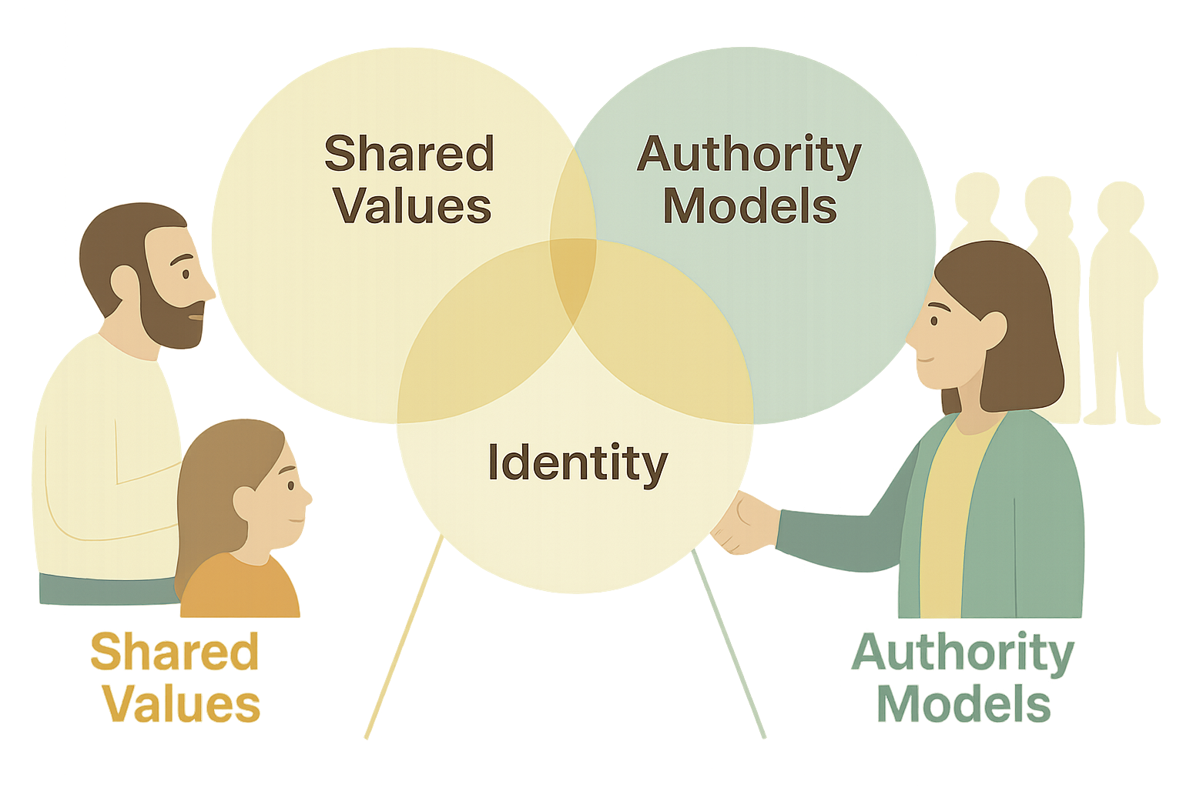
Behavioral Compliance Theories
Determines what “Safety” looks like
Influences how the regulator is perceived
Impacts rules on gender, race and religion
Notes:
“To understand why human services licensing works the way it does, or doesn’t, we have to move beyond rules and talk about behavior.” Modern regulatory theory increasingly shows that compliance is not just a technical act. It’s a human behavior. In human services, providers don’t comply simply because a rule exists; they comply because of how they experience that rule and the system enforcing it.
Behavioral compliance theories help explain what ‘safety’ actually looks like in practice, and why the same rule can produce very different outcomes across communities.
First, these theories remind us that definitions of safety are socially constructed. In human care settings, safety isn’t just physical, it’s emotional, psychological, relational, and often cultural. What one community sees as safe, another may experience as harmful or intrusive. Licensing rules inevitably reflect those value judgments, whether we acknowledge them or not.
Second, behavioral theory highlights that how regulators are perceived matters. Providers are far more likely to comply when they see regulators as: Legitimate, Fair, Consistent and Focused on outcomes rather than punishment. When regulators are perceived primarily as punitive or disconnected from real‑world practice, compliance becomes defensive, minimal, or performative. We get box‑checking instead of safer care.
Third, compliance is strongly influenced by identity and belonging. Rules intersect with issues of culture, language, gender roles, religion, and family structure—especially in human services. When licensing frameworks fail to account for those dimensions, they can unintentionally silence legitimate care practices, exclude culturally responsive providers or reinforce inequities rather than address them. From a behavioral lens, resistance or non‑compliance is often not defiance—it’s a signal that rules are misaligned with lived reality. This is why modern compliance models, including Fiene’s work, emphasize legitimacy, clarity, and proportionality. People are more likely to comply when expectations are understandable, enforcement is risk‑focused and oversight feels reasonable and justified. This is not about being “soft” on standards. It’s about being strategic. Behavioral compliance theories ask regulators to design systems that support willing compliance, not just enforce minimum adherence.
For U.S. regulators, this matters deeply because:
Human services are delivered in culturally diverse contexts
Providers operate under stress, workforce shortages, and resource constraints
And public trust in government systems cannot be taken for granted
The takeaway from this slide is simple but powerful: Compliance improves when regulation aligns with how people actually make decisions—not how we assume they do.
Behavioral compliance theories don’t replace rules. They strengthen them by helping regulators design oversight systems that people understand, trust, and engage with.
And that brings us to the core challenge in human services licensing: How do we protect vulnerable populations while regulating human behavior in all its complexity? As we move into the final slide, I want you to listen for three things:
What today’s regulatory evidence tells us to stop doing
What effective systems are doing differently
And where U.S. regulators have the greatest opportunity to improve outcomes without increasing burden
“The key takeaways aren’t theoretical. They’re practical. And most of them are already within reach of existing licensing systems.”

Slide 29

Key Takeaways
Licensing reflects competing regulatory theories
Modern trend:
  Risk-based
  Evidence-driven
  Flexible oversight
  Focused on harm prevention
Goal:
  Better regulation
  Balance public protection with efficiency and innovation
Notes:
As we close, I want to bring everything we’ve covered today into focus.”
Licensing is not a neutral or purely technical tool. It reflects competing regulatory theories, political choices, administrative capacity, and assumptions about how people behave. Whether we acknowledge it or not, every licensing system embeds values about risk, trust, and responsibility. The dominant global trend today is clear. Modern licensing systems are becoming:
Risk‑based
Evidence‑driven
Flexible in oversight
And focused on harm prevention rather than procedural perfection
Across countries and sectors, regulators are moving away from uniform enforcement and toward differentiated oversight—allocating attention where it matters most, and easing burden where risk is demonstrably low. The goal is not deregulation. The goal is better regulation. What we’ve seen globally is that compliance improves when:
Oversight targets actual risk
Rules are clear and usable
Enforcement is proportional
And regulators are perceived as legitimate risk managers, not box‑checkers
That last point is especially important in human services. When regulation aligns with how providers actually make decisions—under real‑world constraints—compliance shifts from defensive to meaningful. Safety improves not because rules are harsher, but because they are smarter. For U.S. regulators, this creates both a challenge and an opportunity.
The challenge is resisting the pull toward:
Rule accumulation
Uniform enforcement for its own sake
And compliance metrics that don’t predict harm
The opportunity is this:
Most of the improvements we’ve discussed today do not require new statutes, massive restructures, or increased enforcement budgets.
They are fundamentally about design and administration:
How we prioritize risk
How we use data
How we communicate expectations
How we exercise discretion
“The evidence is clear: effective licensing systems protect the public best when they focus on harm, behavior, and risk—not when they attempt to do everything equally.” As regulators, the work ahead is not about choosing between safety and flexibility. It’s about building systems that achieve both—systems that are credible, adaptive, and worthy of public trust.
That is the real measure of modern regulatory effectiveness.

Slide 30

Questions
Sonya.stevens@naralicensing.org

