Slide 1
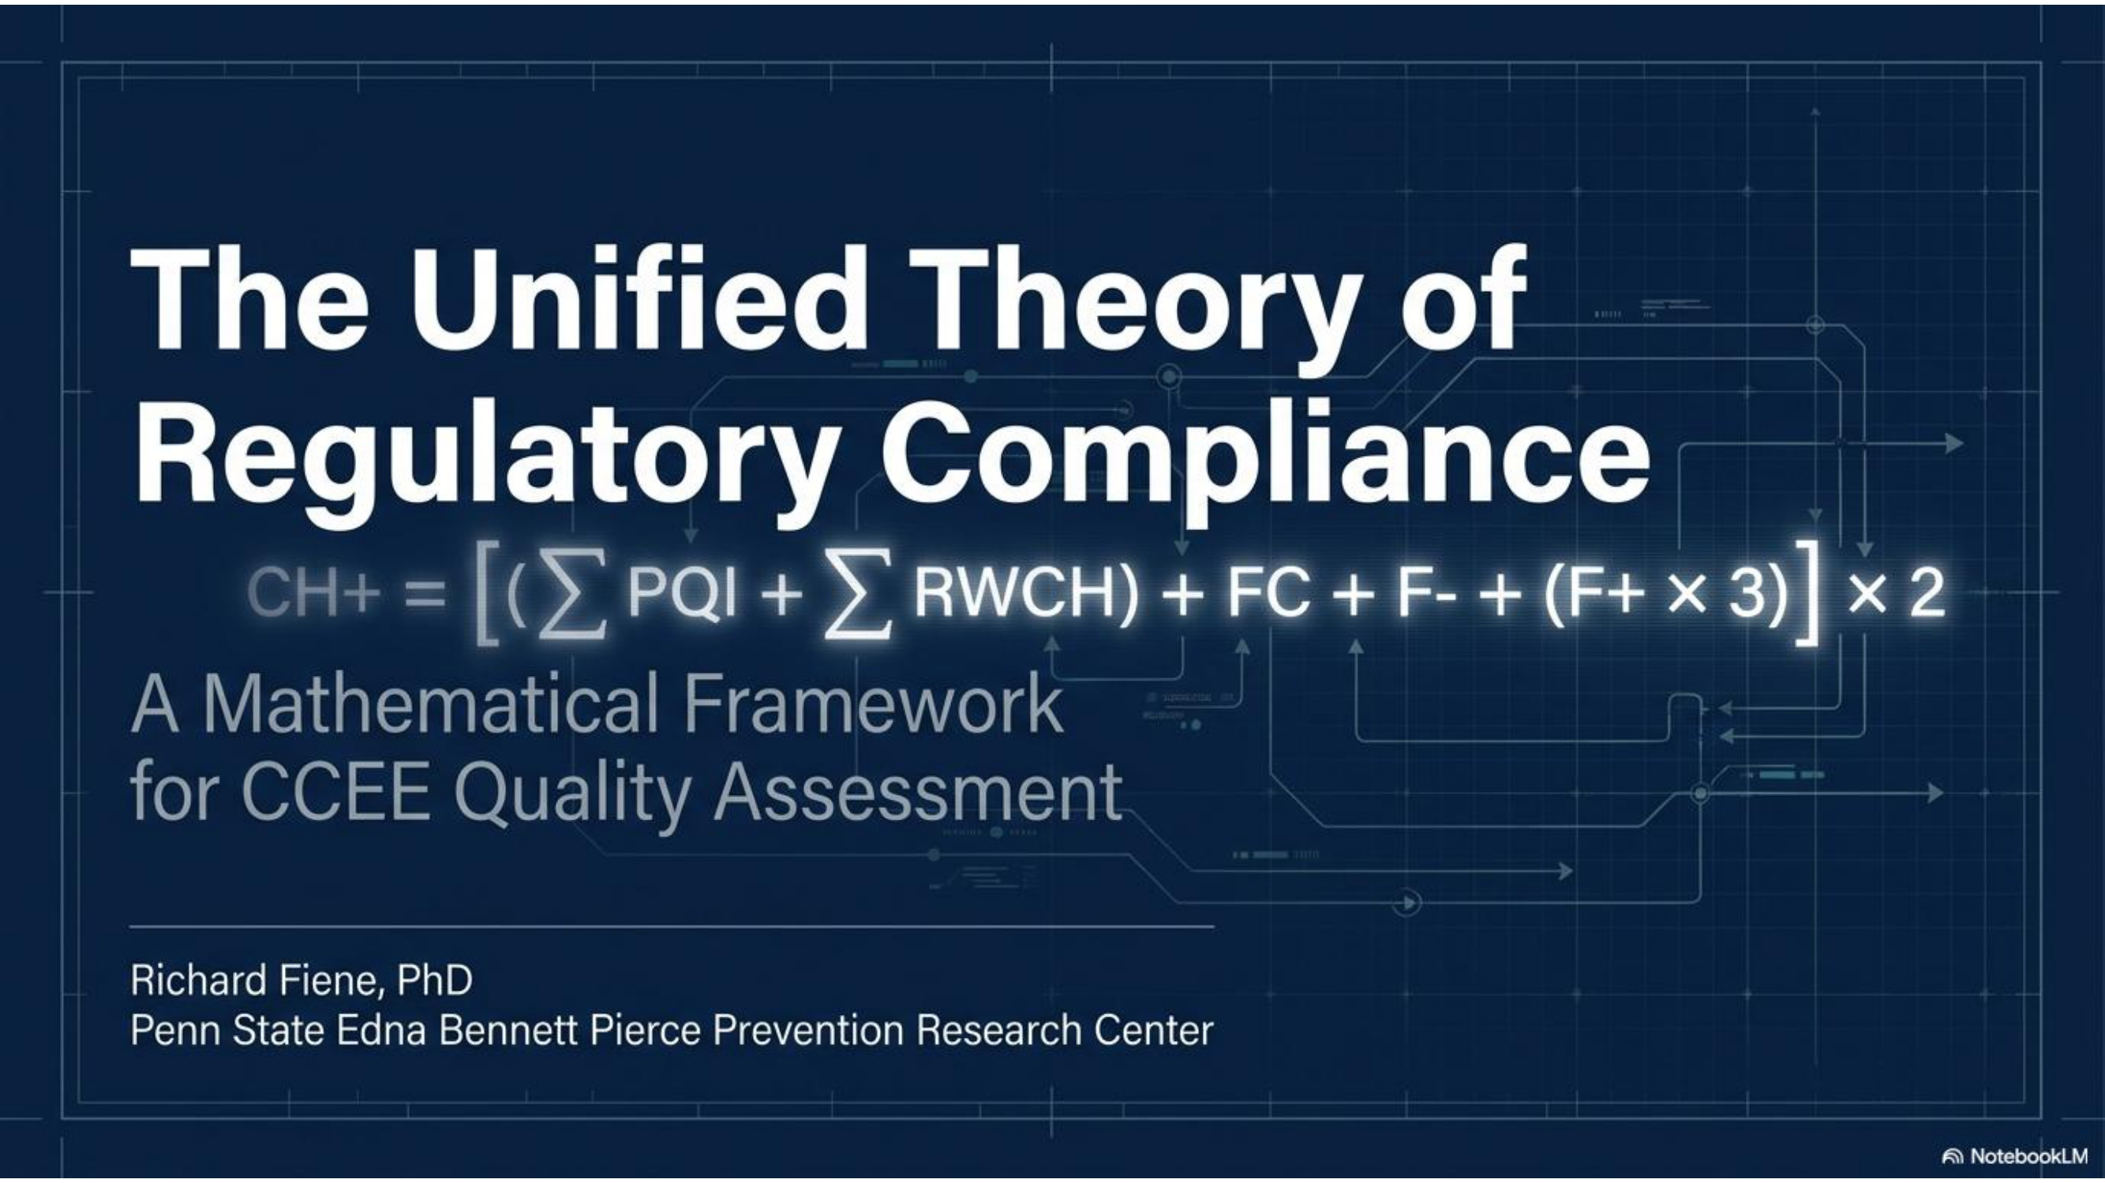
Notes:
This slide deck will provide the details of the unified theory of regulatory compliance diminishing returns which takes the original theory to its logical end point by infusing program quality into the regulatory compliance equation. This slide deck summarizes 50 years of research on the theory.

Slide 2
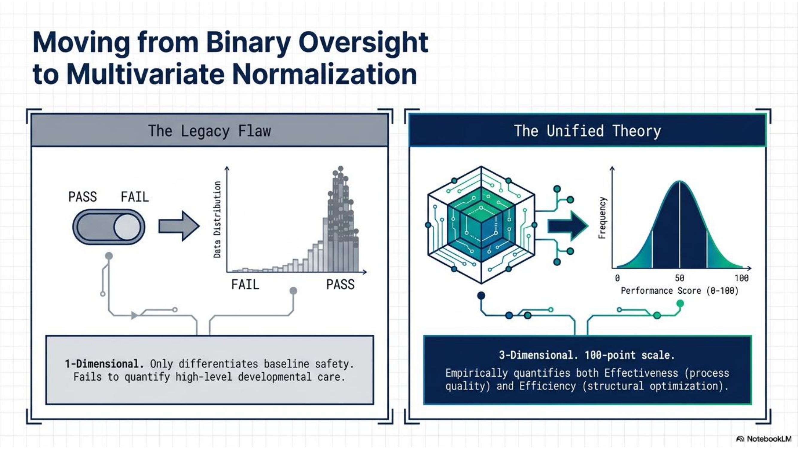
Notes:
One of the major problems with regulatory compliance data is that it is measured at a nominal level and is terribly skewed making it very difficult to distinguish between high quality programs and mediocre programs. Also, regulatory compliance has only focused on health and safety metrics. The unified theory of regulatory compliance moves this to infusing quality into the equation and moves a one dimensional metric to three dimensional. By doing this, it quantifies both effectiveness and efficiency into the equation and provides a more robust performance score that can be measured on a 0 – 100 scale which is more generally normally distributed. By doing this it eliminates the skewness in the data and moves the nominal measurement to more of an ordinal measurement scale.

Slide 3
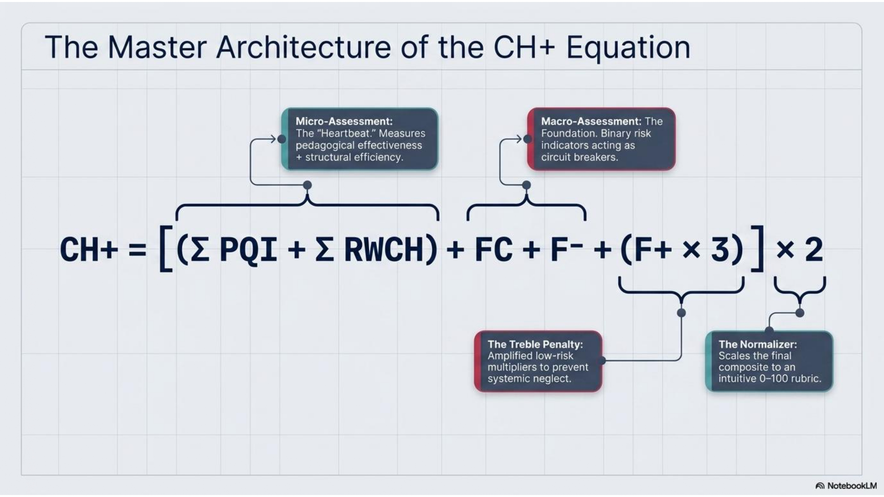
Notes:
This slide is the key slide for the presentation by unpacking the equation into its various components: micro and macro assessment and the key elements of each component. The macro assessment elements of FC and F- are all or none switches. If they are not zero than it is not possible to continue with scoring because a more comprehensive evaluation needs to be done within the health and safety domain. The FC predicts other areas of non-compliance while F- deals with high risk rules and these need to be corrected immediately. F+ leaves some leeway based upon the ceiling effect and the role of substantial compliance but that leeway is limited to no more than 2 non-compliance with low risk rules. Any more than that and again it stops the scoring phase and moves the inspection phase to a more comprehensive review.

Slide 4
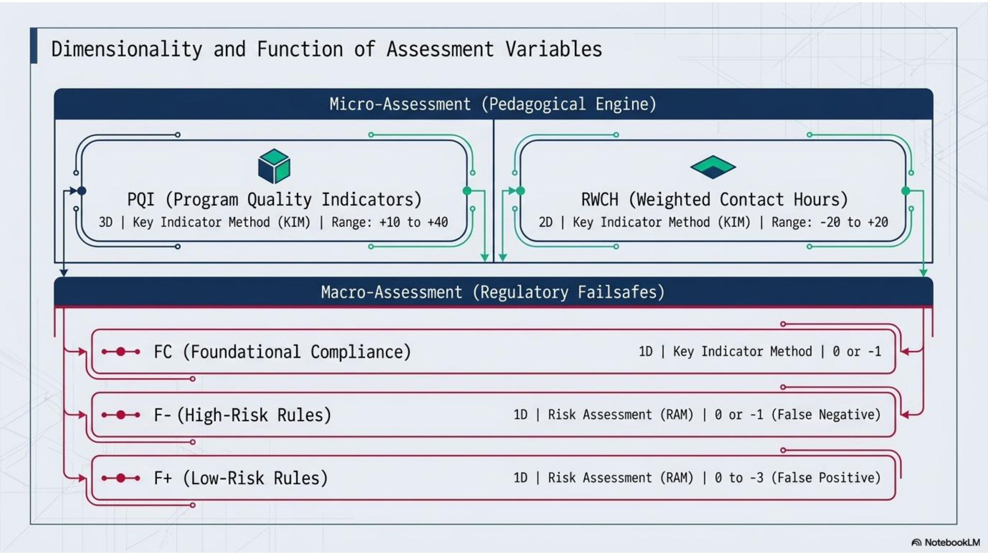

Slide 5


Slide 6
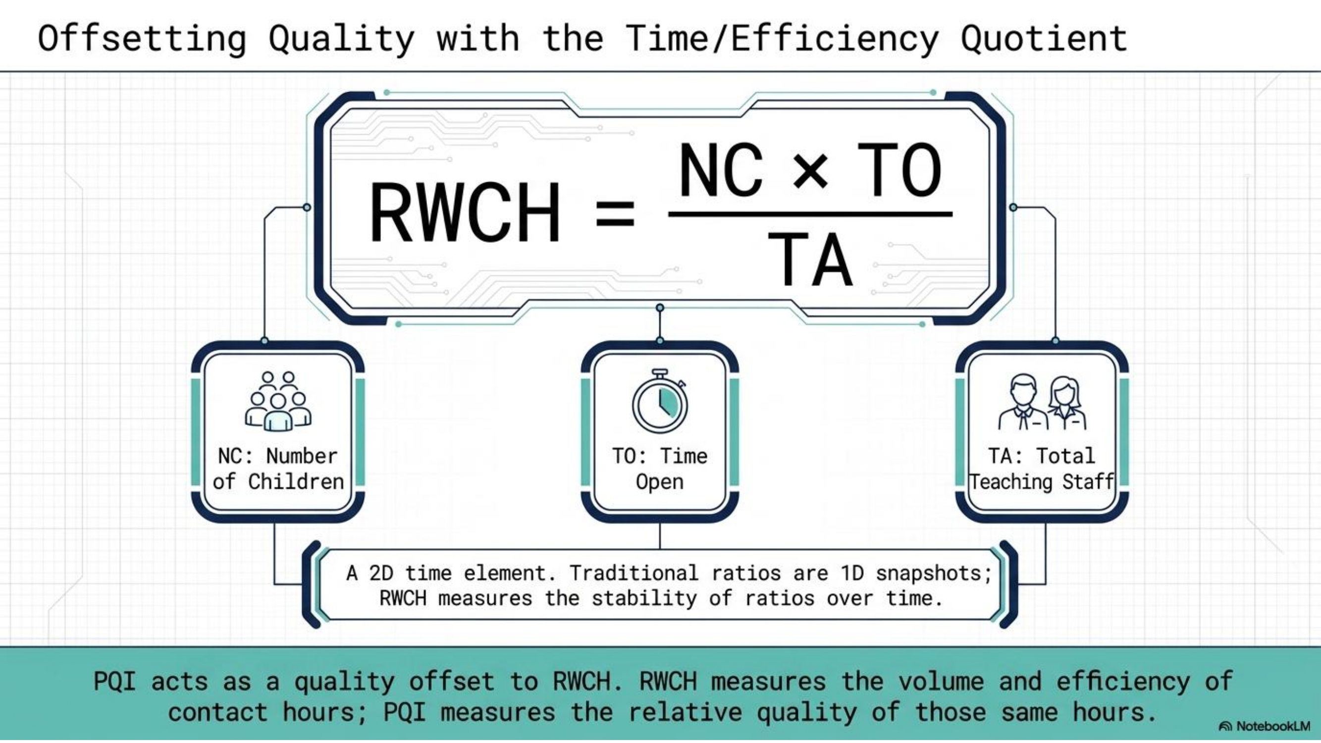

Slide 7
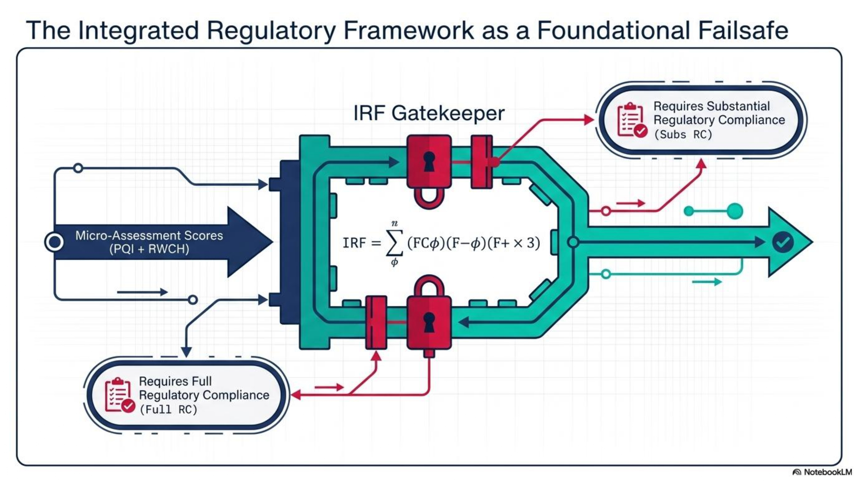

Slide 8
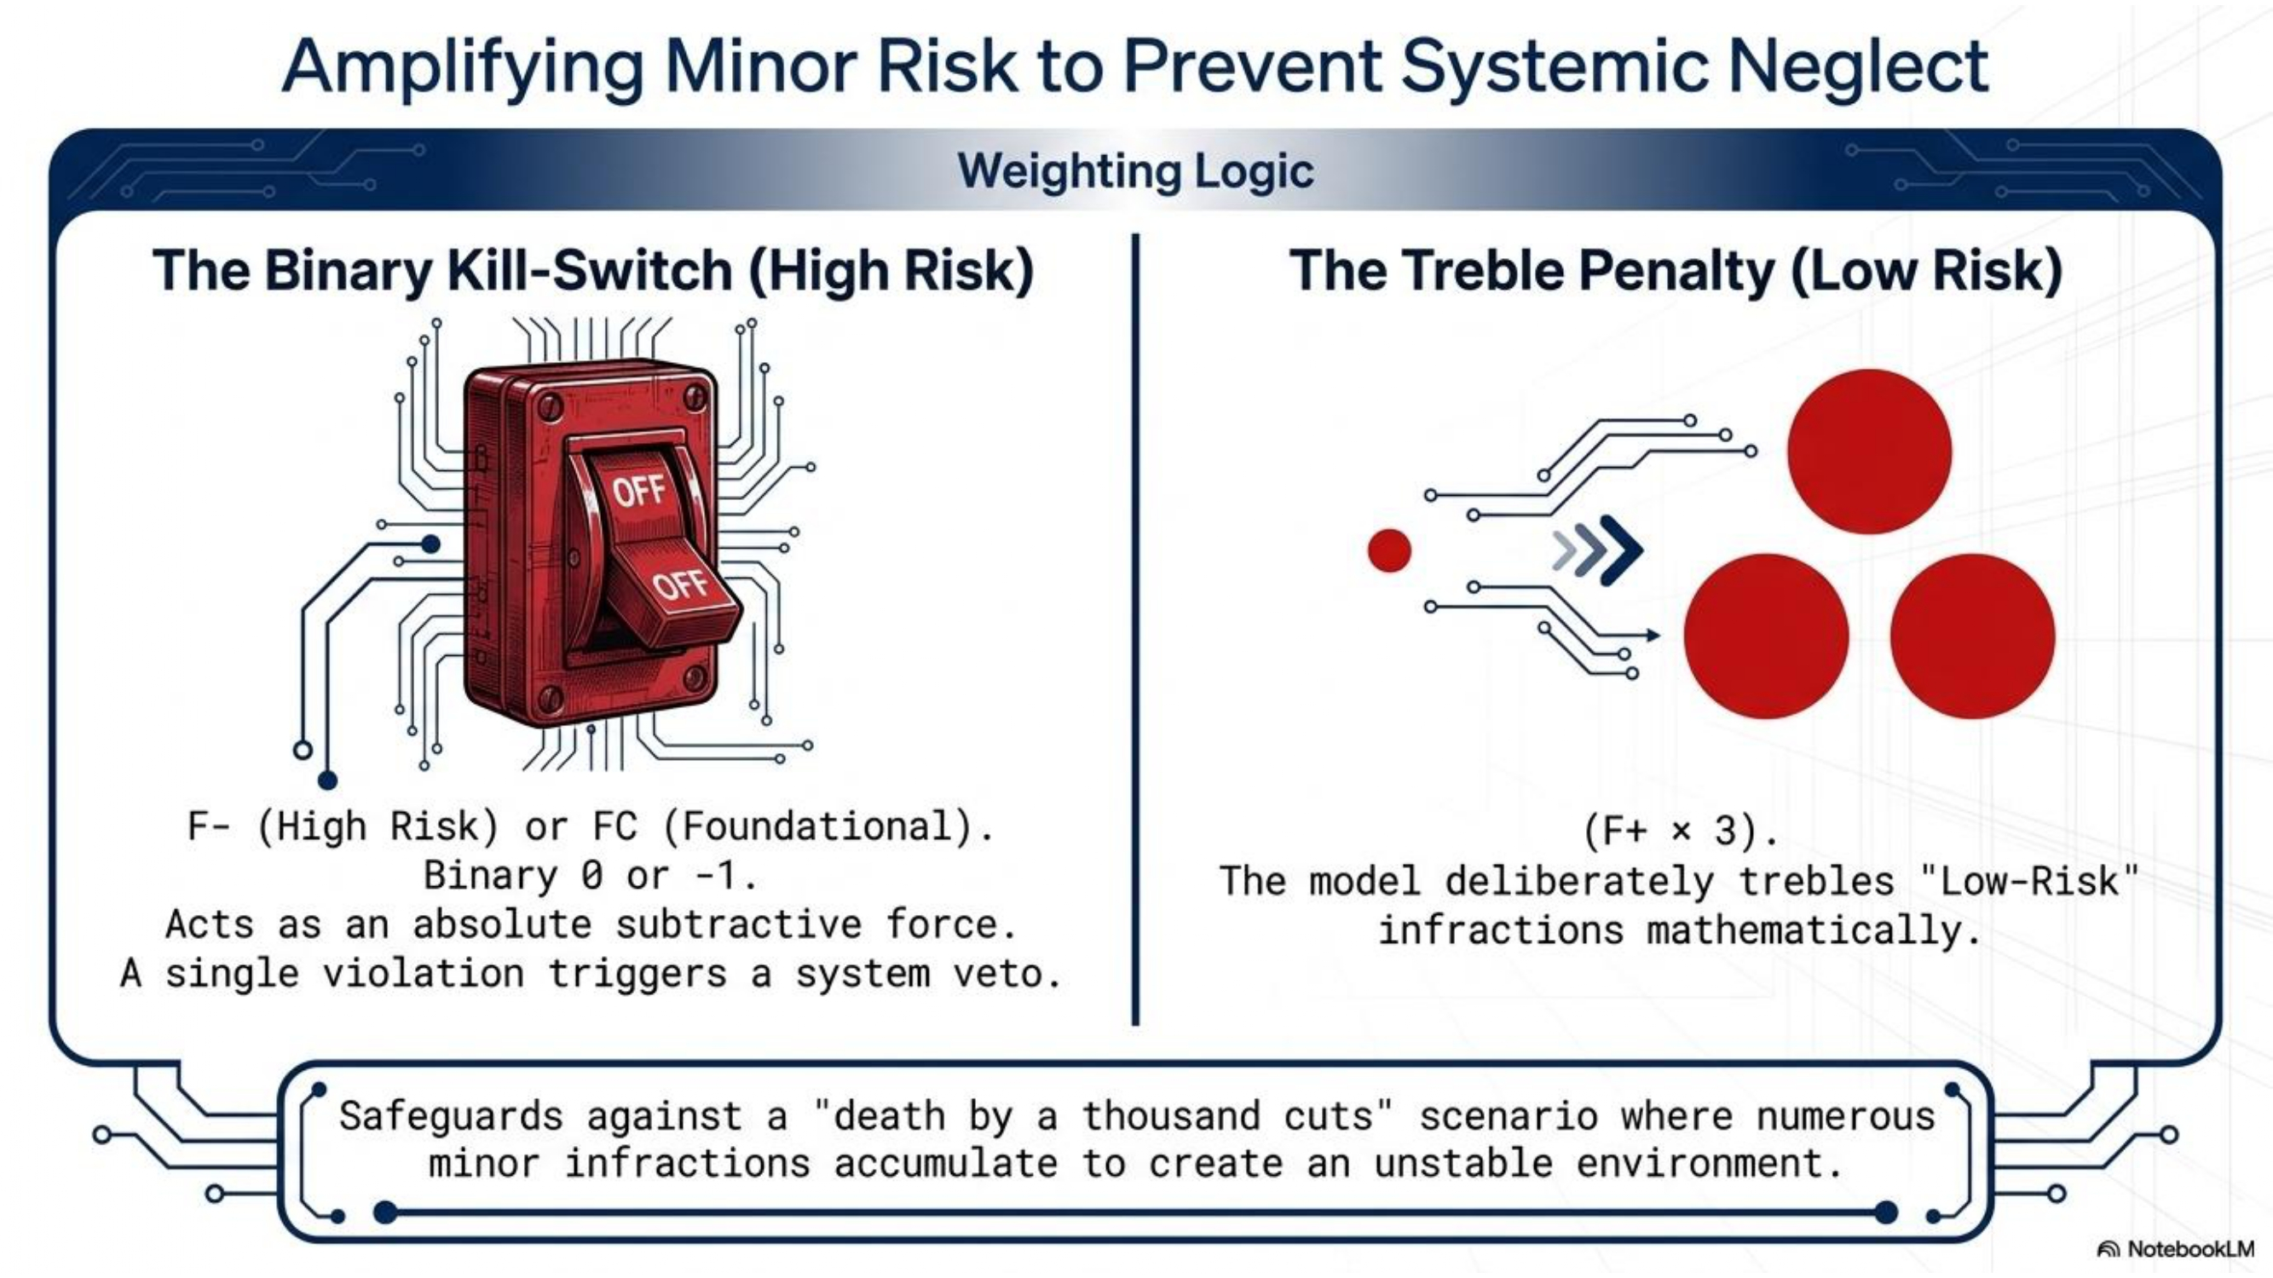

Slide 9
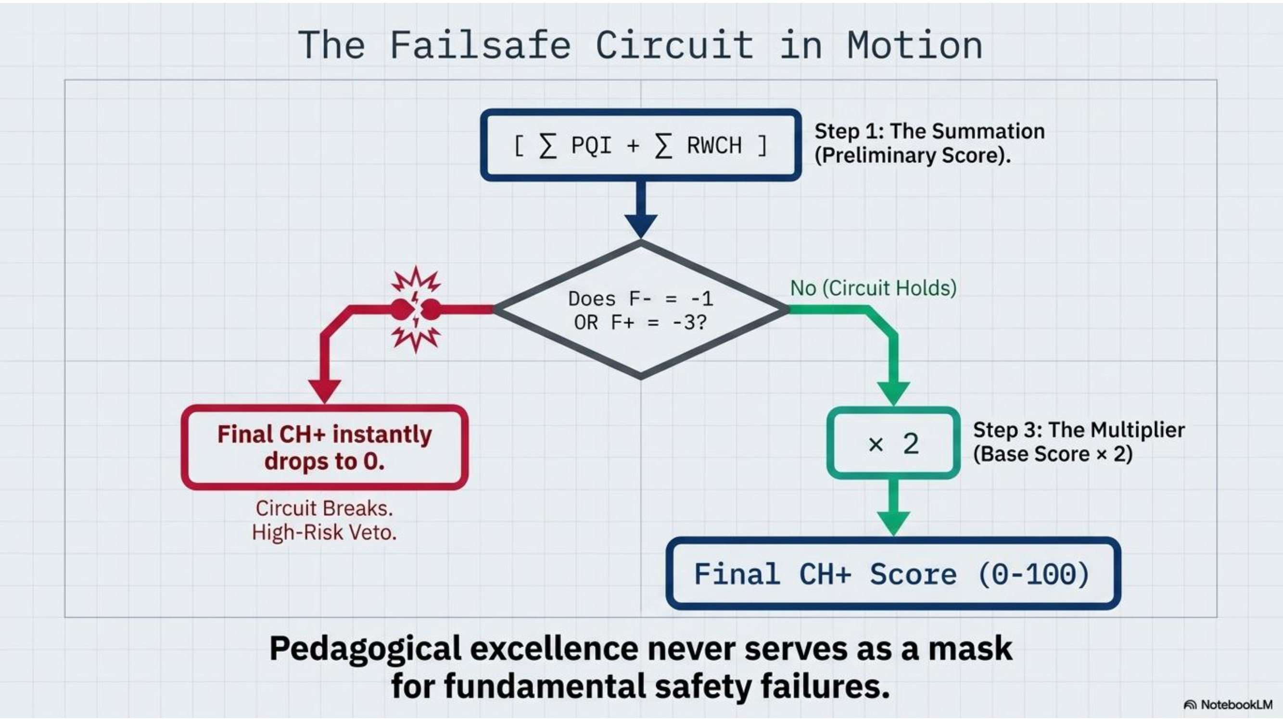

Slide 10
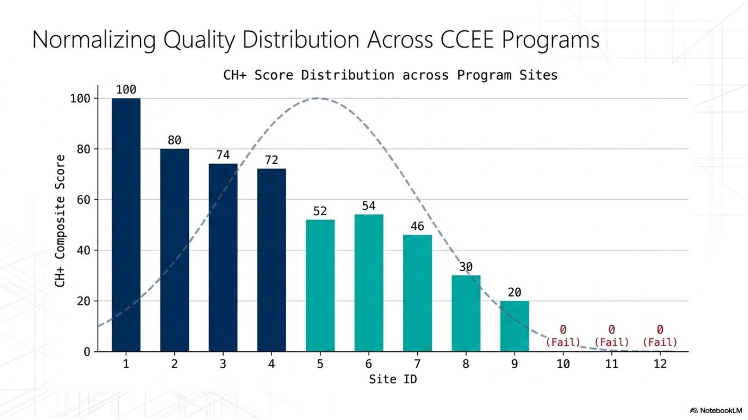

Slide 11
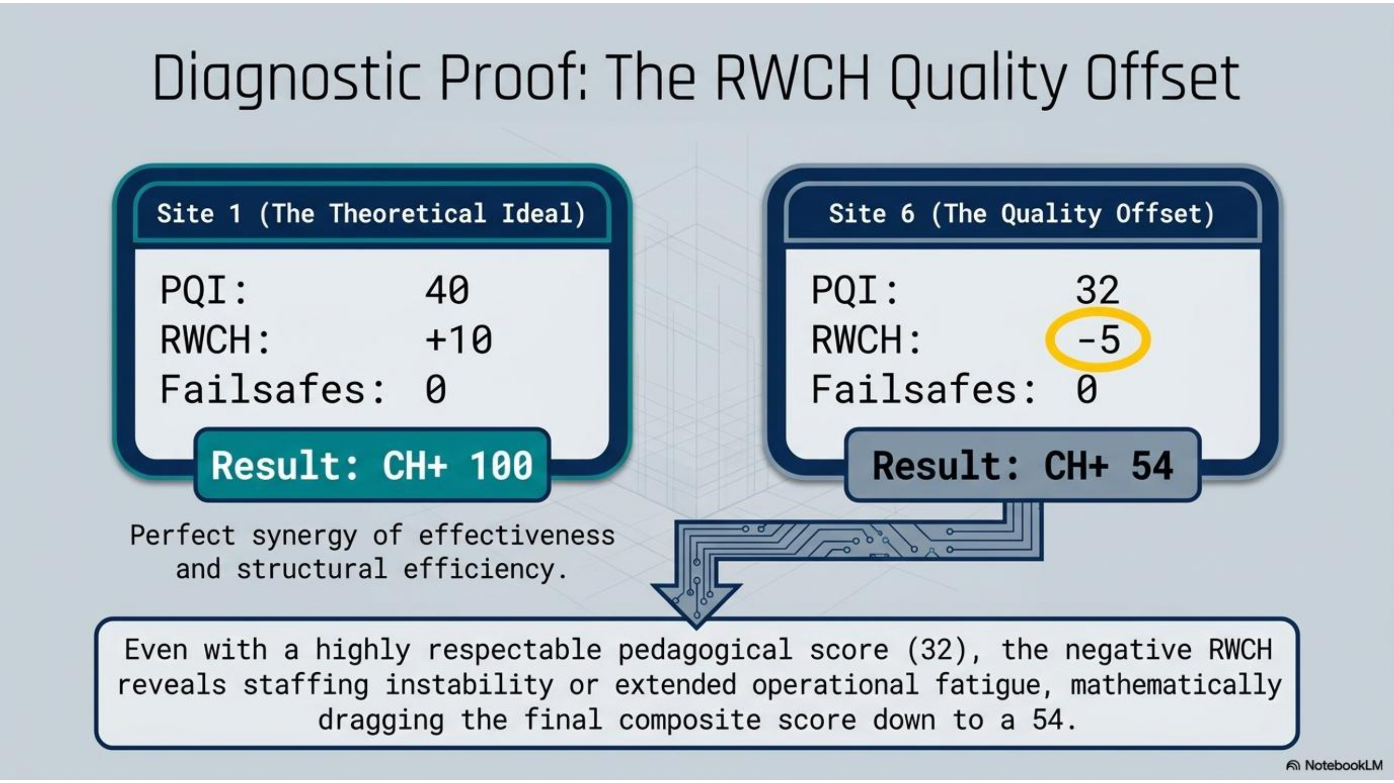

Slide 12
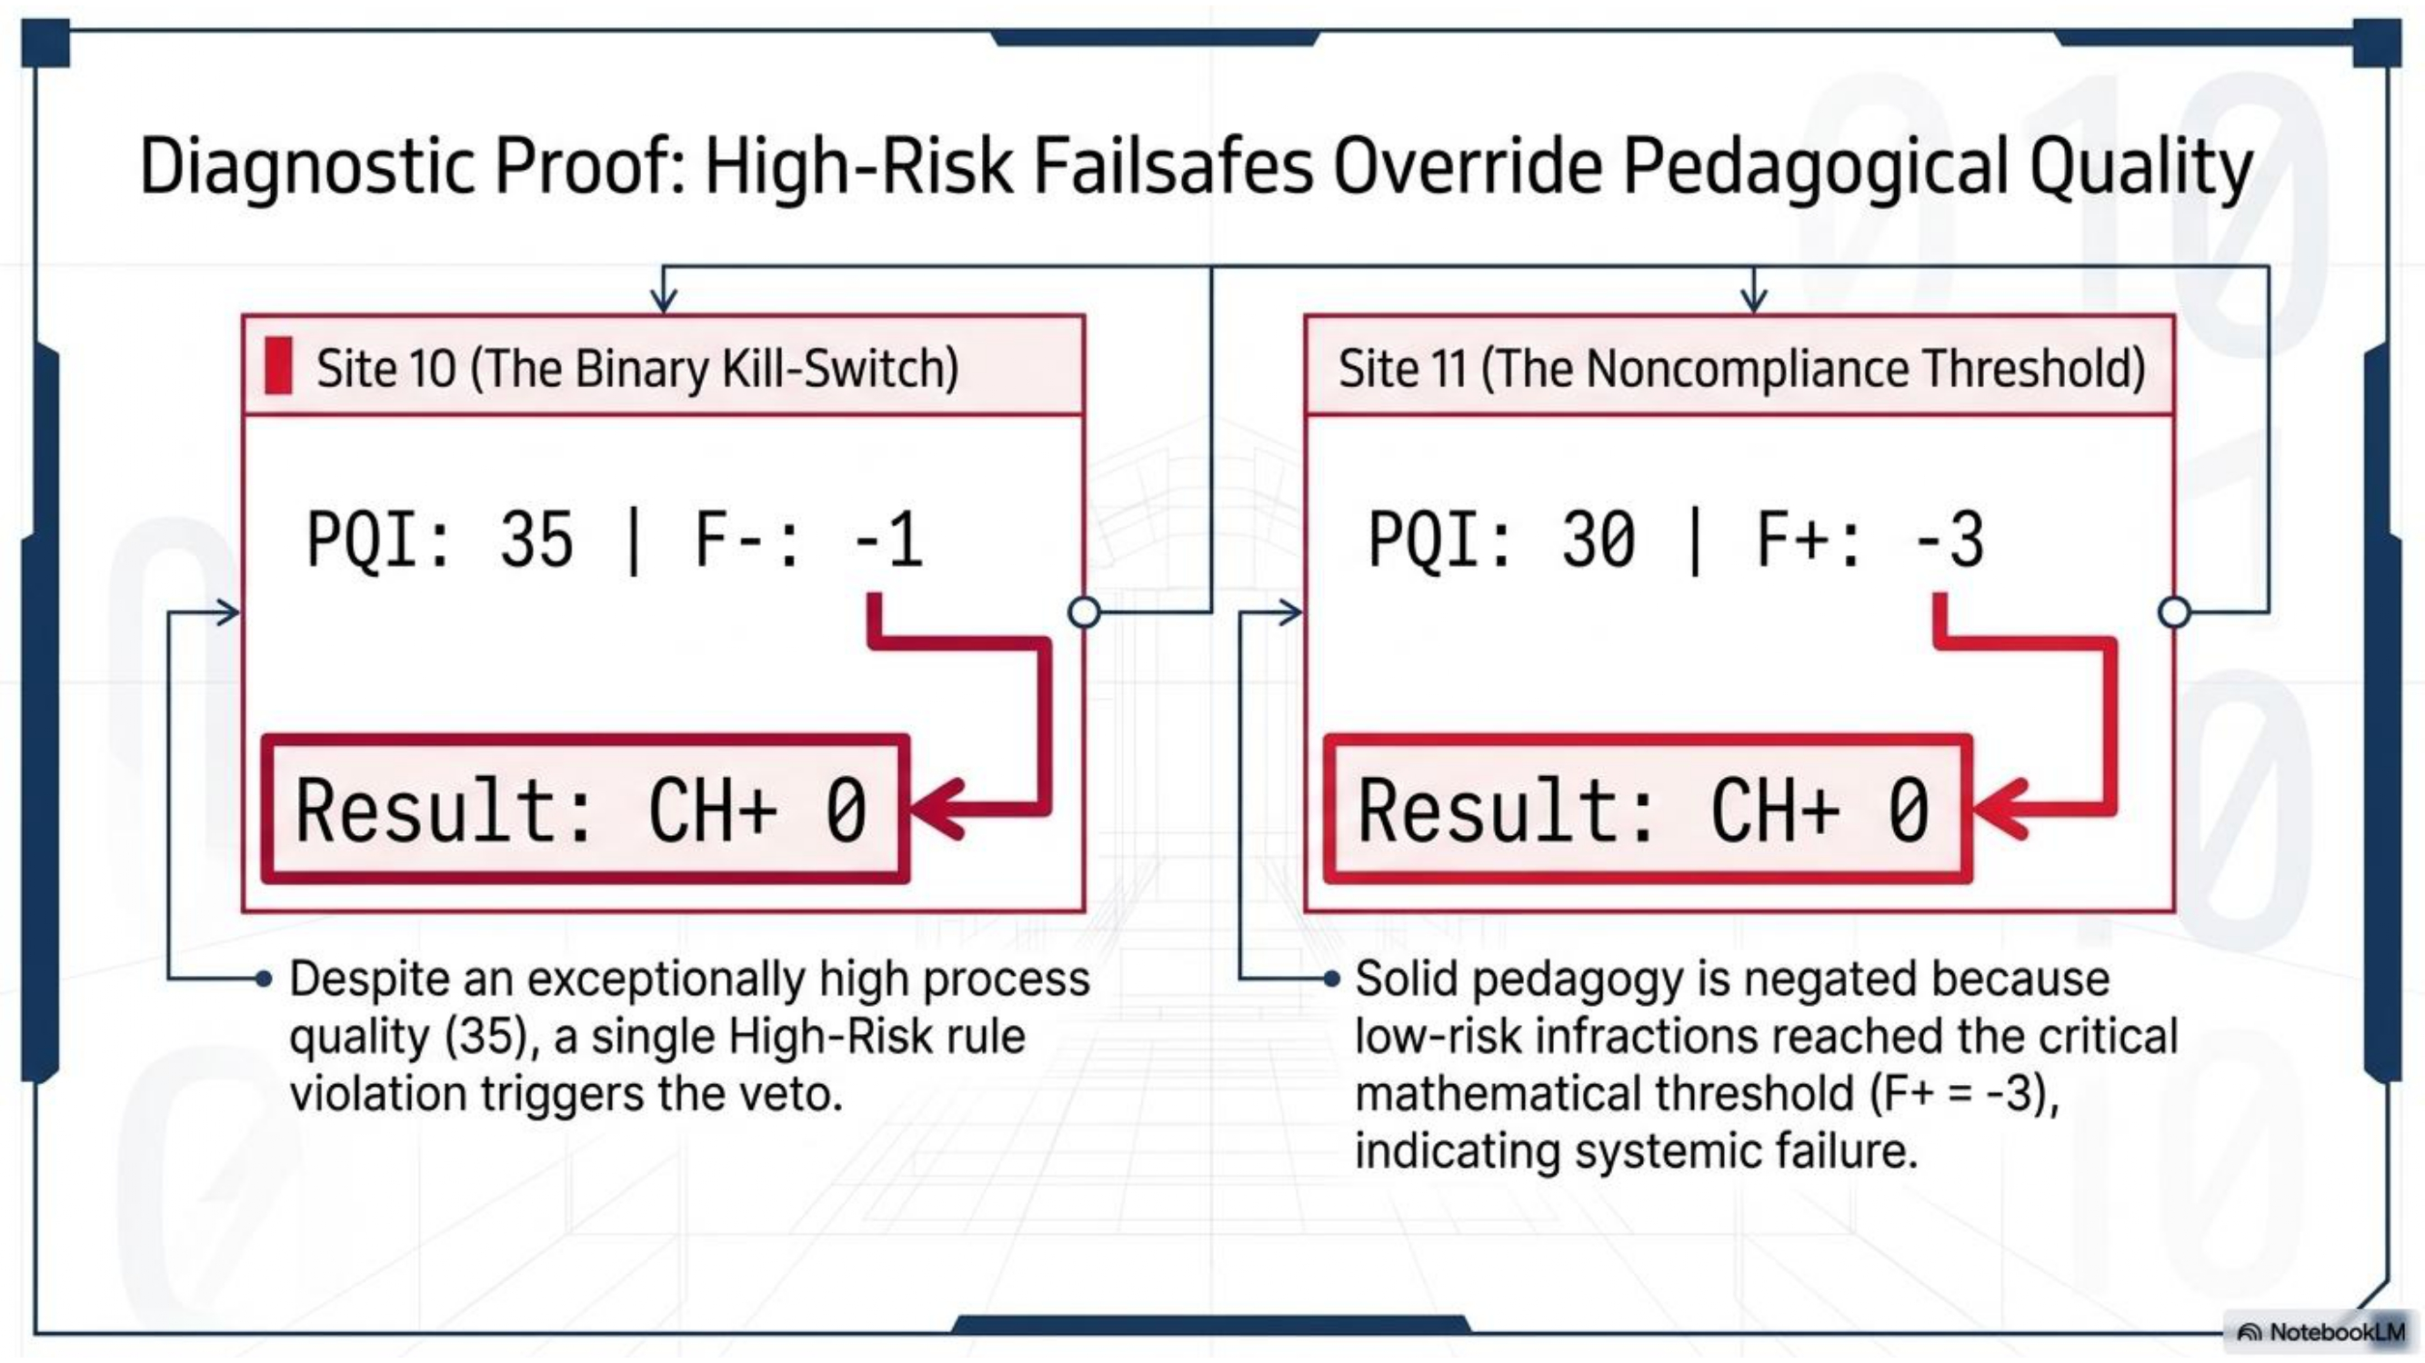

Slide 13
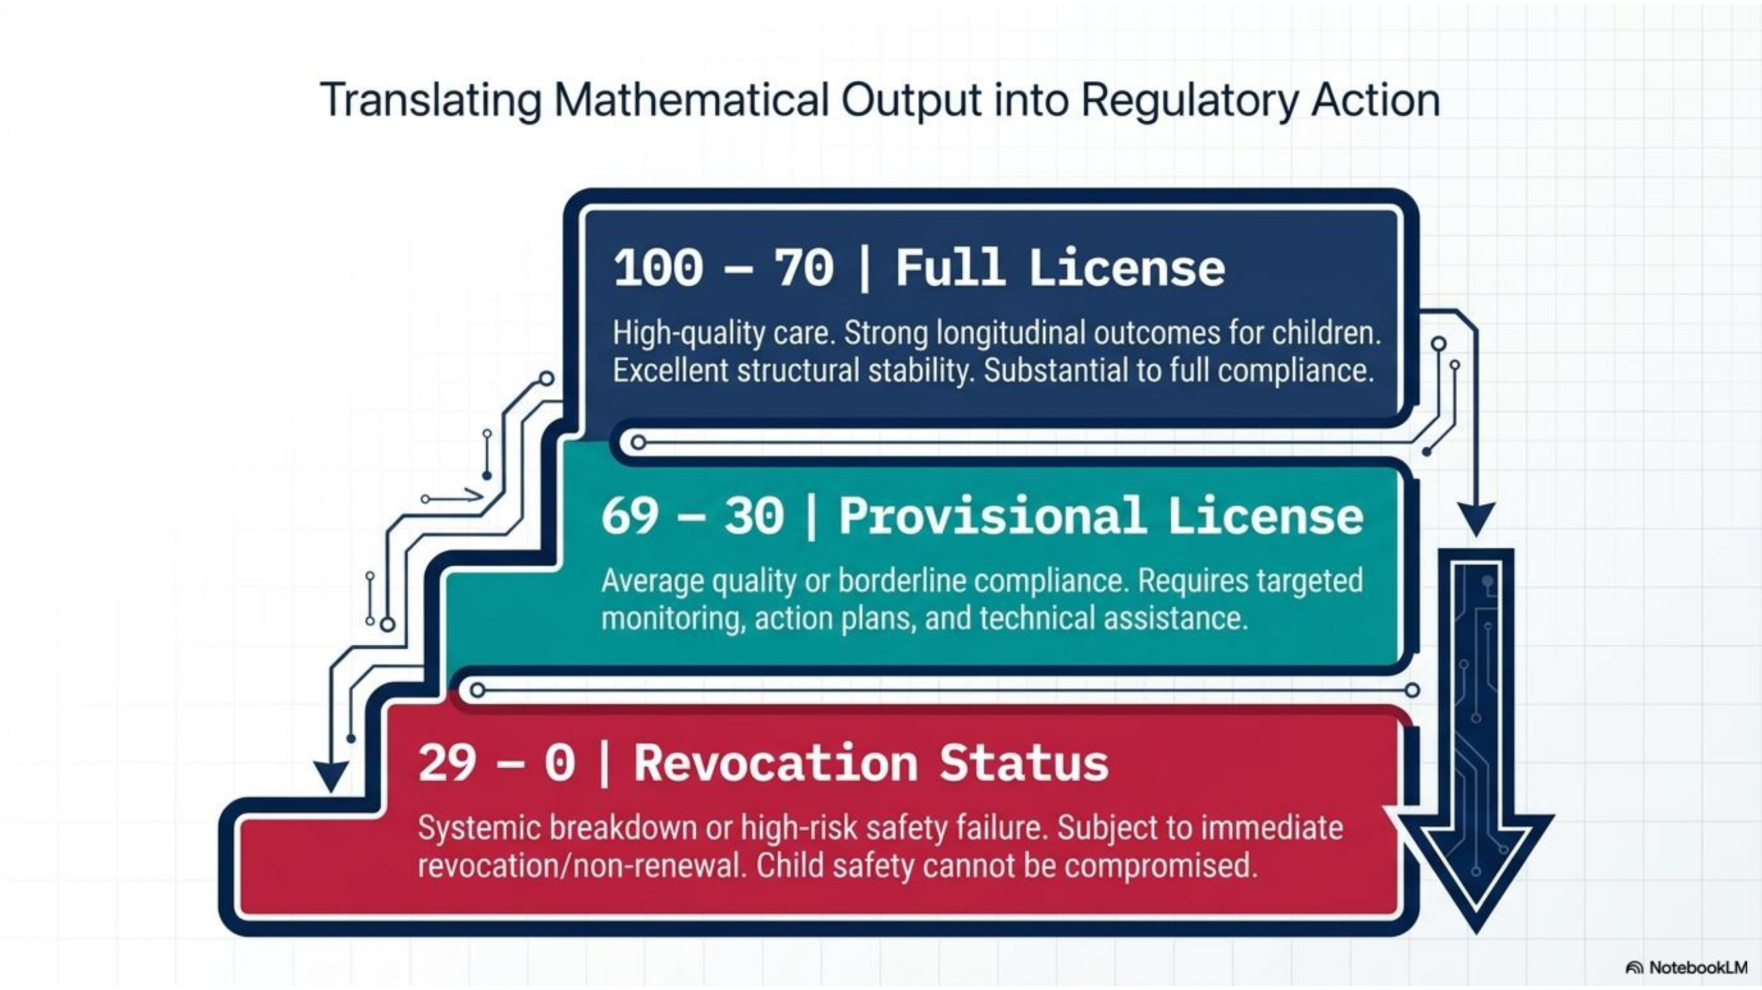
Notes:
This slide clearly demonstrates how the new theory moves the measurement metric from nominal to ordinal levels. This type of Regulatory Compliance Scale (RCS) is far more efficient and effective as a measurement strategy for the human care licensing field. Counting licensing and regulatory compliance violations is not effective in distinguishing between high quality and mediocre programs. This move from a 1-dimensional type of assessment to a more 3-dimensional assessment is just so much more effective.

Slide 14

Notes:
For additional information, please contact the author: Richard Fiene PhD, Research Psychologist & Regulatory Scientist, Research Institute for Key Indicators Data Lab, Penn State Edna Bennett Pierce Prevention Research Center, rfiene@rikinstitute.com
Use the following links for examples of the potential CH+ Output and the CH+ App:
DimRegSci Output
https://gemini.google.com/share/9b1b0e4c1993
IRF+CH+ Modeler App
https://gemini.google.com/share/3c42af9c51d3

